Slide 1
Computer Communication Network
M.T.Hasan
Department of Electronics and Telecommunication

Slide 2
Computer Communication Network
Text Books:
1. Behrouz A. Forouzan, “Data Communications and Networking”
2. Andrew Tenenbaum, “Computer Networks”
3. Kurose & Ross, “Computer Networking- A top Down Approach featuring the Internet”
4. William Stallings, “computer Networks and Cryptography”

Slide 3
Objectives
1. To explain the basic concept of computer communication network.
2. To explain the computer network layer.
3. To explain IP addressing scheme.
4. To explain network process.
5. To study Hardware aspect of network communication.
6. To make selection of IEEE LAN standards.
7. To explain network security & administration.

Slide 4
Outcome
By the end of course, the students shall be able to:
1. Understand the requirement of theoretical & practical aspect of computer network.
2. Understand the network traffic in computer network.
3. Describe various protocols used in network.
4. Describe the concept of computer network security.
5. Understand the different wired & wireless LAN standards & Routers.

Slide 5
Introduction to Computer Networks
Unit I
Uses of computer Network, Network Software-design Issues for layers, Service primitives and relationship of services to Protocols, Reference models-OSI & TCP/IP, network architectures introduction, Example of networks-X.25, Frame Relay & ATM, Protocols and Standards.

Slide 6
Computer Networks
A computer network is an interconnected collection of autonomous computers.
  The goals of a computer network include:
  • Sharing: programs (O.S., applications), data, equipment (printers, disks).
  • High reliability: users are more immune from hardware/software failure.
  • Less cost: It is easy to increase the capacity by adding new machines.
  • Communications medium: Users have access to email and the Internet

Slide 7
Computer Networks

Slide 8
Computer Networks
Uses of Computer Networks
  Business Application
    Resource Sharing: programs (O.S., applications), equipment (printers, disks).
    Information Sharing: data (Client-server model)
  Home Application
    Access to remote information (www, news paper, business, cooking, health, history, etc..)
    Person-to-person communication (text messaging, twitter, etc…)
    Interactive entertainment (Facebook, WhatsApp, hike, etc…)
    Electronic commerce (pay bill, manage bank a/c, online sale/purchase, etc…)
  Mobile Users
    Mobile computers/note book computers
    PDAs

Slide 9
Network Hardware
The user machines in a network are called hosts.
The hosts are connected by a subnet which carries messages between hosts.
The subnet is made up of transmission lines (trunks, channels, circuits) and switching elements (computers).
Computer Networks can be classified by two dimensions:
  Transmission Technology
  Scale

Slide 10
Network Hardware
There are two types of transmission technology (subnet design):
Point-to-Point subnets: Point-to-point links connect individual pairs of machines. (ex. Postal Service, mobile).
  Unicasting – one sender and exactly one receiver
Broadcast subnets: In this system a message is broadcast over the network and all machines have the possibility of receiving the message (ex. LAN, WAN).
  Broadcasting – received and processed by every machine on the network
  Multicasting – received and processed by subset of machines

Slide 11
Network Hardware
Broadcast Sub-networks: These are typically configured as either a bus or a ring network. They can be further classified as Static or Dynamic.
In static broadcast subnet the transmission is done turn by turn.
  Advantage: No collision of message and hence no corruption of message
  Limitation: In-sufficient use of network time
In dynamic broadcast subnet the system allows any station to transmit at any time the network is free of traffic.

Slide 12
Network Hardware
Point to Point Networks: The second type of subnet, the point to point subnet, is mainly found in Wide Area Networks (WANs).
If possible, the point to point subnet transmits directly to the relevant station. If no direct route is available, it will send the message to a "switch" which re-transmits the message to the destination.
The best known example of this type of network is the telephone network (Public Switched Telephone Network or PSTN).

Slide 13
Network Hardware
In Point to point model, nodes either employ circuit switching or packet switching.
In circuit switching,
  a dedicated communication path is allocated between A and B, via a set of intermediate nodes.
  the data is sent along the path as a continuous stream of bits.
In packet switching,
  data is divided into packets which are sent from A to B via intermediate nodes.
  each intermediate node temporarily stores the packet and waits for the receiving node to become available to receive it.

Slide 14
Network Hardware

Slide 15
Network Hardware
An alternative criterion for classifying networks is by scale. Distance is important as a classification metric because different technologies are used at different scales.
  Personal Area Network (meant for one person)
  Longer range Network – LAN, MAN, WAN
  Internetwork

Slide 16
Network Topologies
Computer networks can be configured in a number of ways.
Messages are broken into smaller units called packets for transmission on a network.
  Bus/Ring configuration: Each packet of information is sent off around the ring on its own.
  Complete network: In this configuration each station is connected directly to every other station on the network.
  Loop: Each packet is transmitted along the line until it encounters a computer.
  Tree, Intersecting loop and Star configurations are same as above.

Slide 17
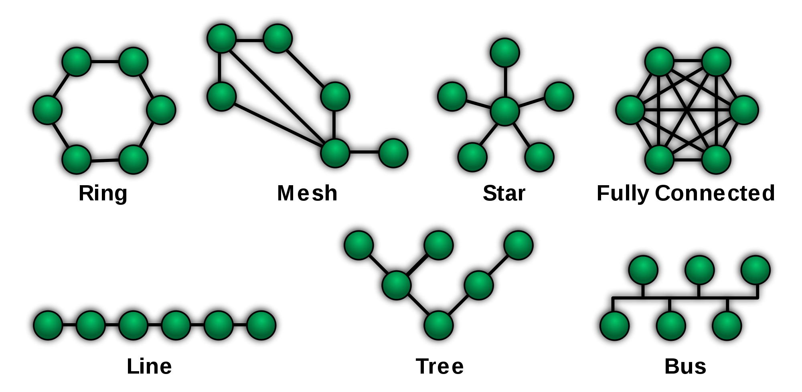
Network Topologies

Slide 18
Personal Area Networks (PAN)
PANs let devices communicate over the range of a person (ex. Computer and its peripherals).
PANs can also be built with other technologies that communicate over short ranges, such as RFID, Bluetooth, etc..
These short range technologies use master-slave
paradigm.

Slide 19
Local Area Networks (LAN)

Slide 20
Local Area Networks (LAN)
A LAN is a privately owned network that operates within and nearby a single building like a home, office or factory.
LANs are widely used to connect personal computers and consumer electronics to let them share resources (ex. printers) and exchange information.
In another configuration it can be used as wireless LAN consisting of a radio modem and an antenna (Access Point).
Typically, wired LANs run at speeds of 100 Mbps to 1 Gbps, have low delay (microseconds or nanoseconds), and make very few errors.
Newer LANs can operate at up to 10 Gbps.
Various topologies are possible for LAN (bus-based, ring-based N/W)
Channel allocation can be Static or dynamic

Slide 21
Metropolitan Area Networks (MAN)
A MAN is a network with a size between a LAN and a WAN.
It normally covers the area inside a town or a city.
It is designed for customers who need a high-speed connectivity, normally to the Internet, and have endpoints spread over a city or part of city (ex. Cable tv, high speed internet access WiMax).
It may be private or public.
It support data & voice.
It has one or more cable and does not contain switching element.

Slide 22
Metropolitan Area Networks (MAN)

Slide 23
Wide Area Networks (WAN)
A WAN spans a large geographical area, often a country or continent.
It is available in two configurations namely switched WAN and poit-to-point WAN.
The switched WAN connects the end systems, which usually comprise a router (internetworking connecting device) that connects to another LAN or WAN (ex. ATM).
The point-to-point WAN is normally a line leased from a telephone or cable TV provider that connects a home computer or a small LAN to an Internet service provider (lSP).

Slide 24
Wide Area Networks (WAN)

Slide 25
Internetworks
A collection of interconnected networks is called an internetwork or internet.
Connecting a LAN and a WAN or connecting two LANs is the usual way to form an internetwork.
People on one n/w can communicate with people on different n/w.
It is widely used to connect universities, government offices, companies and also private individuals.
Applications: Email, News, Remote login, file transfer, etc…

Slide 26
Network Software
The earlier computer networks were designed with the hardware as the main concern and the software as an afterthought.
Now-a-days software are of prime importance and are highly structured.

Slide 27
Network Software

Slide 28
Protocols and Standards
A Protocol is a set of rules that govern data communications
A Protocol defines: what is communicated, how it is communicated, & when it is communicated
There are three elements of a protocol:
  Syntax: The term syntax refers to the structure or format of the data, meaning the order in which they are presented.
  Semantics: The word semantics refers to the meaning of each section of bits. How is a particular pattern to be interpreted, and what action is to be taken based on that interpretation?
  Timing: The term timing refers to two characteristics: when data should be sent and how fast they can be sent.

Slide 29
Protocols and Standards
Standards provide guidelines to manufacturers, vendors, government agencies, and other service providers to ensure the kind of interconnectivity necessary in today's marketplace and in international communication.
Standards are developed through the cooperation of standards creation committees, forums, and government regulatory agencies.
The various standard creation committees are:
  International Organization for Standardization (ISO)
  International Telecommunication Union-Telecommunication Standards Sector (ITU-T)
  American National Standards Institute (ANSI)
  Institute of Electrical and Electronics Engineers (IEEE)
  Electronic Industries Association (EIA)

Slide 30
Design Issues for Layers
There are some key design issues occur in computer networks are present in several layers
    Addressing
    Error control
    Flow control
    Multiplexing
    Demultiplexing
    Routing

Slide 31
Design Issues for Layers
Addressing: Every layer needs a mechanism to identify senders and receivers.
Error Control: Its an important issue because physical communication circuits are not perfect.
  Many error detecting and error correcting codes are available.
  Both sending and receiving ends are must agree to use any one code.
Flow Control: This property leads to mechanisms for disassembling, transmitting and then reassembling messages.

Slide 32
Design Issues for Layers
Routing: When there are multiple paths between source and destination, a route must be chosen.
Multiplexing & Demultiplexing: These two are must for improving the n/w system.
Quality of Service: Most networks must provide service to applications that want this real-time delivery at the same time with high throughput.
Security: The last major design issue is to secure the network by defending it against different kinds of threats.

Slide 33
Interfaces and Services
The function of each layer is to provide services to the layer above it.
The active elements in each layer are called entities.
The entities in layer n implement a service used by layer n+1.
The layer n is called service provider & layer n+1 is called the service user.

Slide 34
Service Primitives
A Primitive means operation
A service in computer network consists of a set of primitives
The primitives are to be used by a user to access the service
The primitives asks the service to do some action or to report on an action
The primitives are system calls
The primitive varies for different services

Slide 35
Service Primitives

Slide 36
THE NEED FOR STANDARDS
Over the past couple of decades many of the networks that were built used different hardware and software implementations, as a result they were incompatible and it became difficult for networks using different specifications to communicate with each other.
To address the problem of networks being incompatible and unable to communicate with each other, the International Organization for Standardization (ISO) researched various network schemes.
The ISO recognized there was a need to create a NETWORK MODEL that would help vendors create interoperable network implementations.

Slide 37
The OSI Reference
Model
Note that the OSI model itself is not a network architecture because it does not specify the exact services and protocols to be used in each layer. It just tells what each layer should do.

Slide 38
The OSI Reference Model
The OSI Reference Model is composed of seven layers, each specifying particular network functions.
Each layer provides a service to the layer above it in the protocol specification.
Each layer communicates with the same layer’s software or hardware on other computers.
The lower 4 layers (transport, network, data link and physical —Layers 4, 3, 2, and 1) are concerned with the flow of data from end to end through the network.
The upper four layers of the OSI model (application, presentation and session—Layers 7, 6 and 5) are orientated more toward services to the applications.
Data is Encapsulated with the necessary protocol information as it moves down the layers before network transit.

Slide 39
OSI Group
The OSI model consists of seven layer is further grouped according to their function into three groups;
Network Group
Transport Group
Application Group

Slide 40
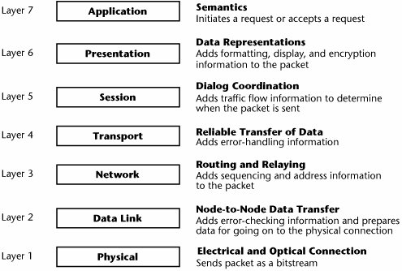
The OSI Reference Model

Slide 41
The Physical Layer
This is lowermost layer of the OSI model. It provides the electrical and mechanical interface to the network medium (cable).
This layer consists of simply the wire or media by which the network signals are conducted. Physical layer includes hardware (wire, plugs and sockets etc.).
In other words, this layer represent the physical aspects of the network such as cable and connectors.
The basic functions of this layer are handles voltages, electrical pulses, connectors and switches so that data can be transmitted from one network device to another.

Slide 42
The Data Link Layer
The data link layer provides access to the networking media and physical transmission across the media and this enables the data to locate its intended destination on a network.
The data link layer provides reliable transit of data across a physical link by using the Media Access Control (MAC) addresses.
The data link layer uses the MAC address to define a hardware or data link address in order for multiple stations to share the same medium and still uniquely identify each other.
Concerned with network topology, network access, error notification, ordered delivery of frames, and flow control.

Slide 43
The Network Layer
This layer establishes the route between the sending and receiving stations.
It handles the routing of data (sending in the right direction to the right destination on outgoing transmissions and receiving incoming transmission at the packet). The layer does routing & forwarding of data.
The network layer also defines how to fragment a packet into smaller packets to accommodate different media.
This layer uses the Internet protocol (IP).

Slide 44
The Transport Layer
The transport layer is responsible for constructing stream of data packets, sending and checking for correct delivery.
This layer manages the end to end control (for example determining whether all packets have arrived) and error checking.
The transport layer ensures data is successfully sent and received between two nodes.
If data is sent incorrectly, this layer has the responsibility to ask for retransmission of the data.
Specially it provides a reliable network independent message interchange service to the application group.
This layer acts as an interface between the bottom and top three layers.
This layer uses of TCP (Transmission Control Protocol) & UDP (User Datagram Protocol).

Slide 45
The Session Layer
The session layer defines how to start, control and end conversations (called sessions) between applications.
This includes the control and management of multiple bi-directional messages using dialogue control.
It also synchronizes dialogue between two hosts' presentation layers and manages their data exchange.
The session layer offers provisions for efficient data transfer.
This layer uses POP, TCP/IP protocols.

Slide 46
The Presentation Layer
The presentation layer ensures that the information that the application layer of one system sends out is readable by the application layer of another system.
If necessary, the presentation layer translates between multiple data formats by using a common format.
Provides encryption and compression of data.
In this layer POP, SMTP, FTP protocol are used.

Slide 47
The Application Layer
The application layer is the OSI layer that is closest to the user.
It provides network services to the user’s applications.
It differs from the other layers in that it does not provide services to any other OSI layer, but rather, only to applications outside the OSI model.
Examples of such applications are spreadsheet programs, word processing programs, and bank terminal programs.
The application layer establishes the availability of intended communication partners, synchronizes and establishes agreement on procedures for error recovery and control of data integrity.

Slide 48
The TCP/IP Reference Model
A set of protocols allowing communication across diverse networks
It is named from two of the most important protocols in it:
  the Transmission Control Protocol (TCP) and
  the Internet Protocol (IP).
The TCP/IP protocol suite is the engine for the Internet and networks worldwide.
The main design goal of TCP/IP was to build an interconnection of networks, referred to as an internetwork, or internet, that provided universal communication services over heterogeneous physical networks.

Slide 49
The TCP/IP Reference Model

Slide 50
Network Interface Layer (Link)
Responsible for sending and receiving TCP/IP packets on the network medium (physical/Data Link)
Applicable LAN technologies
  Ethernet, Token Ring, FDDI (Fiber Distributed Data Interface) etc.
Applicable WAN technologies
  X.25 (old), Frame Relay, ATM etc.
Note that some technologies such as ATM and FDDI may be used at both the WAN and the LAN levels

Slide 51
Internet Layer
Packaging
Addressing
Routing
IP
  A connectionless unreliable protocol that is part of the TCP/IP protocol suite
ARP (Address Resolution Protocol)
  Resolves IP addresses to MAC addresses
ICMP (Internet Control Message Protocol)
  Diagnostics and error reporting
IGMP (Internet Group Management Protocol)
  Management of group multicast

Slide 52
Internet Layer
The internetwork layer, also called the internet layer or the network layer, provides the “virtual network” image of an internet (this layer shields the higher levels from the physical network architecture below it).
Internet Protocol (IP) is the most important protocol in this layer. It is a connectionless protocol that does not assume reliability from lower layers.
IP does not provide reliability, flow control, or error recovery. These functions must be provided at a higher level.

Slide 53
Transport Layer
Sequencing and transmission of packets
Acknowledgment of receipts
Recovery of packets
Flow control
In essence, it engages in host-to-host transportation of data packets and the delivery of them to the application layer.
TCP (Transmission Control Protocol): provides connection-oriented reliable data delivery, duplicate data suppression, congestion control, and flow control.
UDP (User Datagram Protocol): provides connectionless, unreliable, best-effort service. UDP is used by applications that need a fast transport mechanism and can tolerate the loss of some data.

Slide 54
Application Layer
The application layer is provided by the program that uses TCP/IP for communication.
The interface between the application and transport layers is defined by port numbers and sockets.
This layer contains all the high level protocols: virtual terminal (TELNET), file transfer (FTP) and electronic mail (SMTP).
The virtual terminal protocol allows a user on one machine to log into a distant machine and work there.
The file transfer protocol provides a way to more data efficiency from one machine to other.

Slide 55
Comparison of OSI & TCP/IP Models
The OSI & TCP/IP models are more or less similar. The layer functionality is similar.
The two models can be distinguished based on concepts:
  Service; Interfaces; Protocols
OSI: Each layer in OSI performs some service for the layer above it. A layer’s interface tells the processes above it how to access it. The peer protocol used in the layer are the layer’s own business. It can use ant protocol it want to.
TCP/IP: The TCP/IP model did not clearly distinguish between service, interface and protocol.

Slide 56
Comparison of OSI & TCP/IP Models
The OSI model was devised before the invention of protocols, hence they are not biased towards one particular set of it.
The OSI model have 7 layers while TCP/IP have only 4 layers.
The OSI model supports both connectionless and connection-oriented communication in the network layer, but only connection-oriented communication in the transport layer.
The TCP/IP model has only one connectionless mode in the network layer but supports both modes in the transport layer.

Slide 57
X.25 Network
X.25 is a standard for WAN communications that defines how connections between user devices and network devices are established and maintained.
It is typically used in the packet-switched networks (PSNs) of common carriers, such as the telephone companies.
Subscribers are charged based on their use of the network.
The devices used in X.25 network fall into three general categories:
  data terminal equipment (DTE),
  data circuit-terminating equipment (DCE),
  packet-switching exchange (PSE)

Slide 58
X.25 Network

Slide 59
X.25 Network
Data Terminal Equipment (DTE) devices are end systems that communicate across the X.25 network.
They are usually terminals, personal computers, or network hosts, and are located on the premises of individual subscribers.
Data communication Equipment (DCEs) are communications devices, such as modems and packet switches that provide the interface between DTE devices and a PSE, and are generally located in the carrier's facilities.
Packet-switching Exchange (PSEs) are switches that compose the bulk of the carrier's network. They transfer data from one DTE device to another through the X.25 PSN.

Slide 60
X.25 Network
Packet Assembler/Disassembler
The packet assembler/disassembler (PAD) is a device commonly found in X.25 networks.
The PAD is located between a DTE device and a DCE device and it performs three primary functions:
  buffering (storing data until a device is ready to process it),
  packet assembly,
  and packet disassembly

Slide 61
X.25 Network
The X.25 protocol suite maps to the lowest three layers of the OSI reference model. The layers are:
Physical layer: Deals with the physical interface between an attached station and the link that attaches that station to the packet-switching node. X.21 is the most commonly used physical layer standard.

Slide 62
X.25 Network - Protocol Suite
Frame (Link) layer: Facilitates reliable transfer of data across the physical link by transmitting the data as a sequence of frames. Uses Link Access Protocol Balanced (LAPB), bit oriented protocol.
Packet layer: Responsible for end-to-end connection between two DTEs. Functions performed are:
  Establishing connection
  Transferring data
  Terminating a connection
  Error and flow control
  With the help of X.25 packet layer, data are transmitted in packets over external virtual circuits.

Slide 63
Asynchronous Transfer Mode (ATM)
ATM is an international standard for cell relay wherein information for multiple service types, such as voice, video, or data, is conveyed in small, fixed-size cells.
ATM networks are connection-oriented.
Technically, it can be viewed as an evolution of packet switching.
ATM integrates the multiplexing and switching functions, is well suited for bursty traffic (in contrast to circuit switching), and allows communications between devices that operate at different speeds.

Slide 64
ATM Protocol Architecture

Slide 65
ATM Protocol Architecture
Physical layer of the ATM protocol architecture involves the specification of a transmission medium and a signal encoding scheme.
The main functions of the ATM physical layer are as follows:
  Cells are converted into a bit stream,
  The transmission and receipt of bits on the physical medium are controlled,
  ATM cell boundaries are tracked,
  Cells are packaged into the appropriate types of frames for the physical medium.

Slide 66
ATM Protocol Architecture
ATM Layer
  The ATM layer provides routing, traffic management, switching and multiplexing services.
  It processes outgoing traffic by accepting 48-byte segment from the AAL sub-layers and transforming them into 53-byte cell by addition of a 5-byte header.
ATM Adaptation Layer (AAL)
  Mapping the higher-layer information into ATM cells to be transport over an ATM network.
  Collecting information from ATM cells for delivery to higher layers.

Slide 67
ATM Protocol Architecture
The ATM reference model consists of the following planes, which span all layers:
Control—This plane is responsible for generating and managing signaling requests.
User—This plane is responsible for managing the transfer of data.
Management—This plane contains two components:
  Layer management manages layer-specific functions, such as the detection of failures and protocol problems.
  Plane management manages and coordinates functions related to the complete system.

Slide 68
ATM Network Interfaces
An ATM network consists of a set of ATM switches interconnected by point-to-point ATM links or interfaces.
ATM switches support two primary types of interfaces: UNI and NNI.
The UNI (User-Network Interface) connects ATM end systems (such as hosts and routers) to an ATM switch.
The NNI (Network-Network Interface) connects two ATM switches.
UNI and NNI can be further subdivided into public and private UNIs and NNIs.

Slide 69
ATM Cell Format
ATM transfers information in fixed-size units called cells.
Each cell consists of 53 octets, or bytes.
The first 5 bytes contain cell-header information, and the remaining 48 contain the payload (user information).
Small, fixed-length cells are well suited to transfer voice and video traffic because such traffic is intolerant to delays that result from having to wait for a large data packet to download, among other things.

Slide 70
Frame Relay
Frame Relay is a high-performance WAN protocol that operates at the physical and data link layers of the OSI reference model.
Frame Relay originally was designed for use across Integrated Services Digital Network (ISDN) interfaces
Frame Relay is based on packet-switched technology.
The following two techniques are used in packet-switching technology:
  Variable-length packets
  Statistical multiplexing

Slide 71
Frame Relay

Slide 72
Frame Relay
Devices attached to a Frame Relay WAN fall into the following two general categories:
  Data terminal equipment (DTE)
  Data circuit-terminating equipment (DCE)
Examples of DTE devices are terminals, personal computers, routers, and bridges.
DCEs are carrier-owned internetworking devices. The purpose of DCE equipment is to provide clocking and switching services in a network, which are the devices that actually transmit data through the WAN. In most cases, these are packet switches.

Slide 73
Physical Layer
Unit II
Physical layer-Data rate limits, Transmission media-guided and Unguided, Switching systems-Circuit switching, Datagram Switching & Virtual circuit switching, Structure of circuit and packet switch, cable modem and DSL technologies, SONET basics, selection of IEEE std 802.11 ,a,b,c,g.

Slide 74
Physical Layer
Physical layer defines the electrical, timing and other interfaces by which bits are sent as signals over channels.
The physical layer is the foundation on which the network is built.
The major task of physical layer is to provide services for the data link layer.
The physical layer must also take care of the physical network i.e. the transmission medium.

Slide 75
Data Rate Limits
A very important consideration in data communications is how fast we can send data, in bits per second, over a channel. Data rate depends on three factors:
  The bandwidth available
  The level of the signals we use
  The quality of the channel (the level of noise)
Two theoretical formulas were developed to calculate the data rate by:
  Nyquist for a noiseless channel.
  Shannon for a noisy channel.

Slide 76
Noiseless Channel: Nyquist Bit Rate
For a noiseless channel, the Nyquist bit rate formula defines the theoretical maximum bit rate
BitRate = 2 x bandwidth x log2 L
Where L is the number of signal levels used to represent data
Increasing the levels of a signal may reduce the reliability of the system

Slide 77
Noisy Channel: Shannon Capacity
In reality, we cannot have a noiseless channel; the channel is always noisy.
According to Shannon capacity, the theoretical highest data rate for a noisy channel:
Capacity =bandwidth x log2 (1 +SNR)
In the Shannon formula there is no indication of the signal level, which means that no matter how many levels we have, we cannot achieve a data rate higher than the capacity of the channel.

Slide 78
Transmission Media
Transmission media can be defined as physical path between transmitter and receiver in a data transmission system.
It may be classified into two types:
  Guided: Guided media provide a physical path along which the signals are propagated; these include twisted pair, coaxial cable, and optical fiber.
  Unguided: Unguided media employ an antenna for transmitting through air, vacuum, or water.
The characteristics and quality of a data transmission are determined both by the characteristics of the medium and the characteristics of the signal.

Slide 79
Classes of Transmission Media

Slide 80
Transmission Media
In the design of data transmission systems, key concerns are
  Data rate
  Distance
The factors which determine the data rate and distance are:
  Bandwidth: Higher bandwidth implies higher data rate.
  Transmission impairments:
    Attenuation: Twisted pair has more attenuation than coaxial cable which in turn is not as good as optical fiber
  Interference: Can be minimized by proper shielding in guided media.
  Number of receivers: In a shared link, each attachment introduces attenuation and distortion on the line.

Slide 81
Transmission Media

Slide 82
Guided Transmission Media
Transmission capacity depends on the distance and on whether the medium is point-to-point or multipoint
The three guided media commonly used for data transmission are:
Twisted Pair
Coaxial cable
Optical fiber

Slide 83
Guided Transmission Media

Slide 84
Guided Transmission Media - Twisted Pair

Slide 85
Guided Transmission Media - Twisted Pair
In twisted pair technology:
The two wires are typically ``twisted'' together in a helix to reduce interference between the two conductors.
Twisted pair can be used for both analog and digital communication.
The data rate is inversely proportional to the square of the line length.
Data rate determined by wire thickness and length.
Requires shielding to eliminate interference from other wires impacts signal-to-noise ratio, and ultimately, the data rate.
Low–cost easy to work, low data rate, short range

Slide 86
Types of Twisted Pair
STP (shielded twisted pair): The pair is wrapped with metallic foil or braid to insulate the pair from electromagnetic interference
UTP (unshielded twisted pair): Each wire is insulated with plastic wrap, but the pair is encased in an outer covering
Use: The oldest and the most popular use of twisted pair are in telephony. In LAN it is commonly used for point-to-point short distance communication (say, 100m) within a building or a room.
Advantages: Inexpensive, Flexible and light weight, Easy to work with and install.
Disadvantages: Susceptibility to interference and noise, attenuation problem, Relatively low bandwidth (3000Hz).

Slide 87
Guided Transmission Media - Coaxial Cable

Slide 88
Guided Transmission Media - Coaxial Cable
Coaxial cable (or coax) carries signals of higher frequency ranges than those in twisted pair cable
Coax has a central core conductor of solid or stranded wire (usually copper) enclosed in an insulating sheath, which is, in turn, encased in an outer conductor of metal foil, braid, or a combination of the two.
The outer metallic wrapping serves both as a shield against noise and as the second conductor, which completes the circuit.
This outer conductor is also enclosed in an insulating sheath, and the whole cable is protected by a plastic cover

Slide 89
Guided Transmission Media - Coaxial Cable
Most versatile medium
  LANs, Cable TV, Long-distance telephones, VCR to-TV connections
Advantages: Higher bandwidth
  400 to 600Mhz
  up to 10,800 voice conversations
Can be tapped easily (pros and cons)
Much less susceptible to interference than twisted pair
Disadvantages: High attenuation rate makes it expensive over long distance, Bulky

Slide 90
Guided Transmission Media - Optical Fiber

Slide 91
Guided Transmission Media - Optical Fiber
A fiber-optic cable is made of glass or plastic and transmits signals in the form of light.
Optical fibers use reflection to guide light through a channel.
A glass or plastic core is surrounded by a cladding of less dense glass or plastic.
The difference in density of the two materials must be such that a beam of light moving through the core is reflected off the cladding instead of being refracted into it.

Slide 92
Guided Transmission Media - Optical Fiber
Advantages:
  greater capacity (bandwidth of up to 2 Gbps)
  smaller size and lighter weight
  lower attenuation
  immunity to environmental interference
  highly secure due to tap difficulty and lack of signal radiation
Disadvantages:
  expensive over short distance
  requires highly skilled installers
  adding additional nodes is difficult

Slide 93
Unguided Transmission Media - Wireless
Transmission and reception are achieved using an antenna
  Transmitter sends out the EM signal into the medium
  Receiver picks up the signal from the surrounding medium
Directional transmission
  Transmitter sends out a focused EM beam
  Transmitter and receiver antennae must be carefully aligned
  More suitable for higher frequency signals
Omnidirectional transmission
  Transmitted signal spreads out in all directions
  May be received by many antennae

Slide 94
Methods of Propagation
Unguided signals can travel from the source to destination in several ways: ground propagation, sky propagation, and line-of-sight propagation

Slide 95
Methods of Propagation
In ground propagation, radio waves travel through the lowest portion of the atmosphere, hugging the earth. These low-frequency signals emanate in all directions from the transmitting antenna and follow the curvature of the planet.
In sky propagation, higher-frequency radio waves radiate upward into the ionosphere (the layer of atmosphere where particles exist as ions) where they are reflected back to earth.
In line-of-sight propagation, very high-frequency signals are transmitted in straight lines directly from antenna to antenna. Antennas must be directional, facing each other, and either tall enough or close enough together not to be affected by the curvature of the earth.

Slide 96
Unguided Transmission Media - Microwave
Typically used where laying a cable is not practical (No right-of-way needed)
Parabolic dish shaped antenna (about 10 ft dia) transmits/receives electromagnetic waves in the 2-40 GHz range
Travels in a straight line (line-of-sight propagation)
Maximum distance between antenna in km :- d = 7.14 Sqrt((4/3)h); h: antenna height in meters
High data rates: 100’s Mbps
Repeaters spaced 10 - 100 km apart
Applications
  Long-distance telephone communication

Slide 97
Unguided Transmission Media - Satellite
Uses satellite in geostationary (geosynchronous) orbit (36,000 km)
Source transmits signal to satellite which amplifies or repeats it, and retransmits down to destinations
Optimum transmission in 1 - 10 GHz range; Bandwidth of 100’s MHz
Significant propagation delay (270ms)
Total propagation delay is independent of distance between sender and receiver
Applications: Long-distance telephones, Television distribution, Private business networks

Slide 98
Unguided Transmission Media - Satellite

Slide 99
Unguided Transmission Media - VSAT
VSAT (Very Small Aperture System)
For business data applications requiring high data rates for short periods of time (National Weather Service, news services, credit card verification, automatic tellers, car rental agencies, …)
Commonly connects a central location with many remote ones
Communication between two sites is via a satellite and allows a low-cost small antenna dishes (5 ft)

Slide 100
Unguided Transmission Media - Radio
Electromagnetic wave in the range 30MHz ~ 1GHz
Omnidirectional
As with microwave, d = 7.14 Sqrt((4/3)h); h: antenna height in meters
Less attenuation than microwave since wavelength is larger

Slide 101
Unguided Transmission Media - Infra
For short-range communication
  Remote controls for TVs, VCRs, and stereos
  Indoor wireless LANs
Do not pass through solid walls
  Better security and no interference (with a similar system in adjacent rooms)
No government license is needed
Cannot be used outdoors (due to the sunshine)

Slide 102
Switching
A network is a set of connected devices.
Whenever we have multiple devices, we have the problem of how to connect them to make one-to-one communication possible.
Solution is to make a connection between devices: bus topology, mesh topology, star topology….
These solutions are impractical for a very large network.
A better solution is switching.
A switched network consists of a series of interlinked nodes, called switches.
Switches are devices capable of creating temporary connections between two or more devices linked to the switch.

Slide 103
Switching

Slide 104
Switching
There are three methods of Switching:
  Circuit Switching
  Packet Switching
Networks can be divided into three broad categories:
  circuit-switched networks
  packet-switched networks
    Datagram networks
    Virtual circuit networks

Slide 105
Circuit Switched Networks
A circuit-switched network is made of a set of switches connected by physical links, in which each link is divided into n channels.

Slide 106
Circuit Switched Networks
Circuit switching:
  There is a dedicated communication path between two stations (end-to-end)
  The path is a connected sequence of links between network nodes. On each physical link, a logical channel is dedicated to the connection.
Communication via circuit switching has three phases:
  Circuit establishment (link by link)
    Routing & resource allocation (FDM or TDM)
  Data transfer
  Circuit disconnect
    Deallocate the dedicated resources
The switches must know how to find the route to the destination and how to allocate bandwidth (channel) to establish a connection.

Slide 107
Circuit Switched Networks
Inefficiency
  Channel capacity is dedicated for the whole duration of a connection
  If no data, capacity is wasted
Delay
  Long initial delay: circuit establishment takes time
  Low data delay: after the circuit establishment, information is transmitted at a fixed data rate with no delay other than the propagation delay. The delay at each node is negligible.
Developed for voice traffic (public telephone network) but can also applied to data traffic.

Slide 108
Packet Switching
Data are transmitted in short packets
  Typically at the order of 1000 bytes
  Longer messages are split into series of packets
  Each packet contains a portion of user data plus some control info
Control info contains at least
  Routing (addressing) info, so as to be routed to the intended destination
  Recall the content of an IP header!
store and forward
  On each switching node, packets are received, stored briefly (buffered) and passed on to the next node.

Slide 109
Advantages of Packet Switching
Line efficiency
  Single node-to-node link can be dynamically shared by many packets over time
  Packets are queued up and transmitted as fast as possible
Data rate conversion
  Each station connects to the local node at its own speed
In circuit-switching, a connection could be blocked if there lacks free resources. On a packet-switching network, even with heavy traffic, packets are still accepted, by delivery delay increases.
Priorities can be used
  On each node, packets with higher priority can be forwarded first. They will experience less delay than lower-priority packets.

Slide 110
Datagram Network
Each packet is treated independently, with no reference to packets that have gone before.
  Each node chooses the next node on a packet’s path.
Packets can take any possible route.
Packets may arrive at the receiver out of order.
Packets may go missing.
It is up to the receiver to re-order packets and recover from missing packets.
Example: Internet

Slide 111
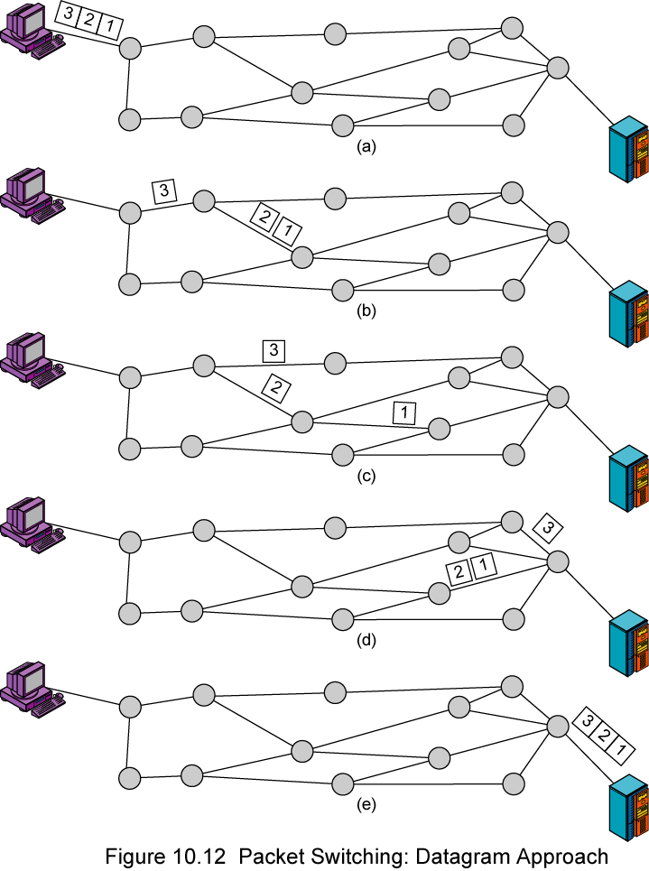
Datagram Network

Slide 112
Virtual Circuit Network
In virtual circuit, a preplanned route is established before any packets are sent, then all packets follow the same route.
Each packet contains a virtual circuit identifier instead of destination address, and each node on the pre-established route knows where to forward such packets.
  The node need not make a routing decision for each packet.
Example: X.25, Frame Relay, ATM

Slide 113
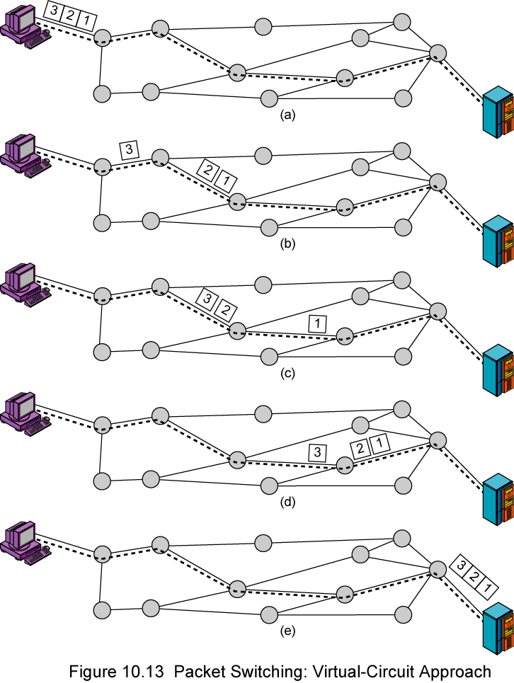
Virtual Circuit Network

Slide 115
Cable Modem
A Cable Modem is a digital modem that uses a coaxial cable connection for the data transmission.
This data connection is received by a cable modem that decodes the signal into your PC.
Cable modems are up to 10-20Mbps downloads.
Typical downloads are over 300Kbps, or close to 600Kbps.
The speed of the cable modem depends on how many users are on the system since the cable technology is a "shared" bandwidth.

Slide 116
Digital Subscriber Line (DSL)
DSL is a broadband high-speed Internet technology that brings high bandwidth information to home and offices over ordinary copper telephone lines.
DSL technology provides high-speed, broadband network connections to homes and small businesses.
DSL utilizes the same cabling used for normal telephones, but it can offer higher data rates through use of the digital modem technology

Slide 117
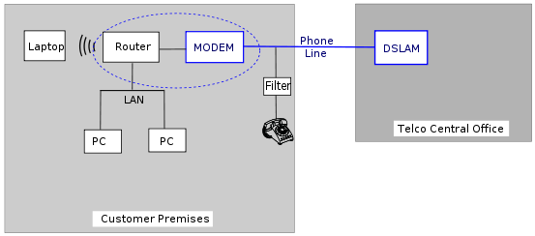
Digital Subscriber Line (DSL)

Slide 118
Digital Subscriber Line (DSL):Types
ADSL(Asymmetric Digital Subscriber Line): The transfer of data from the internet to PC is much faster than the transfer from PC to internet.
VDSL(Very high-bit-rate Digital Subscriber Line): Provides high speed internet connection but works only over a short distance.
SDSL(Symmetric Digital Subscriber Line ): Does not allows to use the phone at the same time. But internet speed of sending and receiving data is same.
RADSL(Rate Adaptive Digital Subscriber Line): This service is a variation of ADSL but the modem can adjust the internet speed.
HDSL(High bit/data rate Digital Subscriber Line): HDSL was the first DSL technology that used a higher frequency spectrum of copper, twisted pair cables.
ISDN DSL(Integrated Service Digital Network): Symmetric data rates of up to 144 kbps using existing phone lines.

Slide 119
DSL vs Cable Modem
Both DSL and Cable Modem technologies offer high-speed Internet access.
Even though they are similar in many respects, the two technologies differ on some fundamental aspects such as:
Speed:-
  Cable can achieve, theoretically, up to 30 Mbps, while most forms of DSL cannot reach beyond 10 Mbps.
Bandwidth:-
  Cable modem technology delivers “shared” bandwidth within the neighbourhood, while DSL delivers “dedicated” bandwidth.

Slide 120
Synchronous Optical Network (SONET)
SONET is a high-speed, fiber-optic system, which provides an interface and mechanism for optical transmission of digital information.
At the interface, signals are converted from electrical to optical form (and back to electrical form at the destination). It is an ANSI standard.

Slide 121
SONET
The SONET network has the following features:
Supports constant bit rate (CBR) connections.
Multiplexes CBR connections into higher speed optical connections by using time division multiplexing.
Uses a four-layer hierarchy to implement and manage the transmission of frames between two endpoints.
Can adjust timing and framing during operation.
Can be used as a carrier service for ATM (Asynchronous Transport Mode) networks.

Slide 122
SONET

Slide 123
SONET
Three basic devices used in the SONET system:
Synchronous Transport Signal (STS) multiplexer/ demultiplexer: It either multiplexes signal from multiple sources into a STS signal or demultiplexes an STS signal into different destination signals.
Regenerator: It is a repeater that takes a received optical signal and regenerates it. It functions in the data link layer.
Add/drop Multiplexer: Can add signals coming from different sources into a given path or remove a desired signal from a path and redirect it.

Slide 124
SONET

Slide 125
SONET
A section is an optical link, connecting two neighboring devices: multiplexer to multiplexer, multiplexer to regenerator, or regenerator to regenerator.
A line is a portion of network between two multiplexers: STS to add/drop multiplexer, two add/drop multiplexer, or two STS multiplexer.
A Path is the end-to-end portion of the network between two STS multiplexers.

Slide 126
SONET Architecture

Slide 127
SONET
SONET defines 4 layers: Photonic layer, Section layer, Line layer, Path layer
The photonic layer includes physical specifications for the optical fiber channel, the sensitivity of the receiver, multiplexing functions and so on. It uses NRZ encoding.
The section layer is responsible for movement of a signal across a physical section. It handles framing, scrambling, and error control.

Slide 128
SONET
Line layer is responsible for the movement of a signal across a physical line. STS multiplexer and add/drop multiplexers provide line layer functions.
The path layer is responsible for the movement of a signal from its optical source to its optical destination. At the optical source, the signal is changed from an electronic form into an optical form, multiplexed with other signals, and encapsulated in a frame. At the optical destination, the received frame is demultiplexed, and the individual optical signals are changed back into their electronic forms.

Slide 129
IEEE Standards 802.11,a,b,g,n
IEEE 802.11 is a set of media access control (MAC) and physical layer (PHY) specifications for implementing wireless local area network (WLAN) computer communication in the 900 MHz and 2.4, 3.6, 5, and 60 GHz frequency bands.
They are created and maintained by the Institute of Electrical and Electronics Engineers (IEEE) LAN/MAN Standards Committee (IEEE 802).
The base version of the standard was released in 1997, and has had subsequent amendments.

Slide 130
IEEE 802.11 Wireless LAN Standard
LANs provide connectivity for interconnecting computing resources at the local levels of an organization
Wired LANs
    Limitations because of physical, hard-wired infrastructure
Wireless LANs provide
    Flexibility
    Portability
    Mobility
    Ease of Installation

Slide 131
IEEE 802.11 Wireless LAN Standard
In response to lacking standards, IEEE developed the first internationally recognized wireless LAN standard – IEEE 802.11.
IEEE published 802.11 in 1997, after seven years of work.
Scope of IEEE 802.11 is limited to Physical and Data Link Layers.
Benefits of WLAN are:
    Power Management
    Security
    Bandwidth

Slide 132
802.11a
802.11a OFDM (Orthogonal Frequency Divisional Multiplexing)
  Operates in the 5 GHz UNII (Unlicensed National Information Infrastructure) band
  Supports Data rates up to 54 Mbps.
  Incompatible with devices operating in 2.4GHz
  Encoding (OFDM) is complex.
  More difficulty in penetrating walls.

Slide 133
802.11b
802.11b HR-DSSS (High Rate Direct Sequence Spread Spectrum)
  The most popular 802.11 standard currently in deployment.
  Supports 1, 2, 5.5 and 11 Mbps data rates in the 2.4 GHz ISM (Industrial-Scientific-Medical) band
  Note in this bandwidth all the protocols have to deal with interference from microwave ovens, cordless phones and garage door openers.
  Range is 7 times greater than 11a.
  802.11b is used in a point-to-multipoint configuration, wherein an access point communicates via an omnidirectional antenna with mobile clients within the range of the access point.

Slide 134
802.11g
802.11g OFDM(Orthogonal Frequency Division Multiplexing)
  An attempt to combine the best of both 802.11a and 802.11b.
  Supports bandwidths up to 54 Mbps.
  Uses 2.4 GHz frequency for greater range.
  Is backward compatible with 802.11b.

Slide 135
802.11n
Newest member of the 802.11 family.
Has rated 600Mbit/s bandwidth
It can be used in the 2.4 GHz or 5 GHz frequency bands.
Introduces MIMO
  Multiple-Input Multiple-Output
OFDM Modulation
  Uses higher frequencies for increased number of carrier waves

Slide 136
Data Link Layer
Unit III
Data link layer: Framing, Flow & Error control Protocols, HDLC, PPP, Multiple access techniques-random access, controlled access & Channelization, Ethernet types-bridged, Switched, Full duplex, Fast & gigabit Ethernet, Introduction to Data link layer in 802.11 LAN, Connecting devices like passive hubs, repeaters, Active hubs, Bridges, Two-layer Switches, Routers, three layer switches, Gateway etc., Backbone networks, Virtual LANs, Simple Router architecture, Sliding window protocol.

Slide 137
Data Link Layer
Services
  Framing
  Flow & Error control
  Reliability
  Connection management
  Medium access control
  Switching
Protocols
  PPP
  HDLC

Slide 138
Framing
To provide service to the network layer, the data link layer must use the service provided to it by the physical layer.
It breaks up network layer data stream into small blocks, a process called segmentation, and adds header and frame flag to each block to form a frame, a process called encapsulation.
The usual approach is for the data link layer to break up the bit stream into discrete frames called framing. Four methods:
  Byte count.
  Flag bytes with byte stuffing.
  Flag bits with bit stuffing.
  Physical layer coding violations.

Slide 139
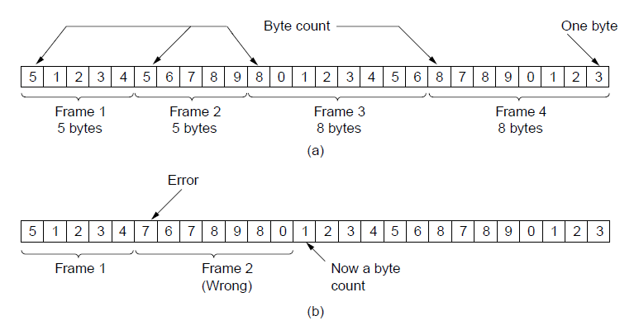
Framing – Byte Count
The first framing method uses a field in the header to specify the number of bytes in the frame.
The trouble with this algorithm is that the count can be garbled by a transmission error.
A byte stream. (a) Without errors. (b) With one error.

Slide 140
Framing – Flag bytes with byte stuffing
Each frame start and end with special bytes called Flag byte.
It is used as both the starting and ending delimiter.
It may happen that the flag byte occurs in the data.
To solve this problem the sender’s data link layer insert a special escape byte (ESC) just before each ‘‘accidental’’ flag byte in the data.
This technique is called byte stuffing

Slide 141
Framing – Flag bits with bit stuffing
Sender adds a 0 bit whenever it encounters five consecutive 1 bits in data, and receiver deletes the 0 bit that follows five consecutive 1 bits in the received data.

Slide 142
Framing – Physical layer coding violations
Uses some reserved signals to indicate the start and end of frames.
In effect, we are using ‘‘coding violations’’ to delimit frames.
Because they are reserved signals, it is easy to find the start and end of frames and there is no need to stuff the data.

Slide 143
Data Link Control
The most important functions of Data Link layer to satisfy the above requirements are error control and flow control.
Flow Control is a technique so that transmitter and receiver with different speed characteristics can communicate with each other.
Error Control involves both error detection and error correction. It is necessary because errors are inevitable in data communication, in spite of the use of better equipment and reliable transmission media based on the current technology.

Slide 144
Flow Control
Flow Control is a technique for speed-matching of transmitter and receiver.
Flow control ensures that a transmitting station does not overflow a receiving station with data.
We will discuss two protocols for flow control:
  Stop-and-Wait
  Sliding Window
For the time being, we assume that we have a perfect channel (no errors)

Slide 145
Stop-and-wait Flow Control
Simplest form of flow control
In Stop-and-Wait flow control, the receiver indicates its readiness to receive data for each frame
Operations:
  1. Sender: Transmit a single frame
  2. Receiver: Transmit acknowledgment (ACK)
  3. Goto 1.

Slide 146
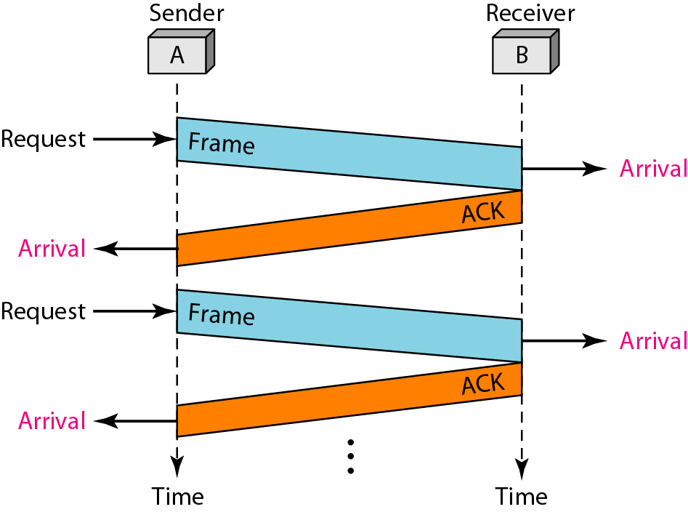
Stop-and-wait Flow Control
The sender must wait until it receives the ACK frame before sending the next data frame.
Major drawback of Stop-and-Wait Flow Control is that only one frame can be in transmission at a time.

Slide 147
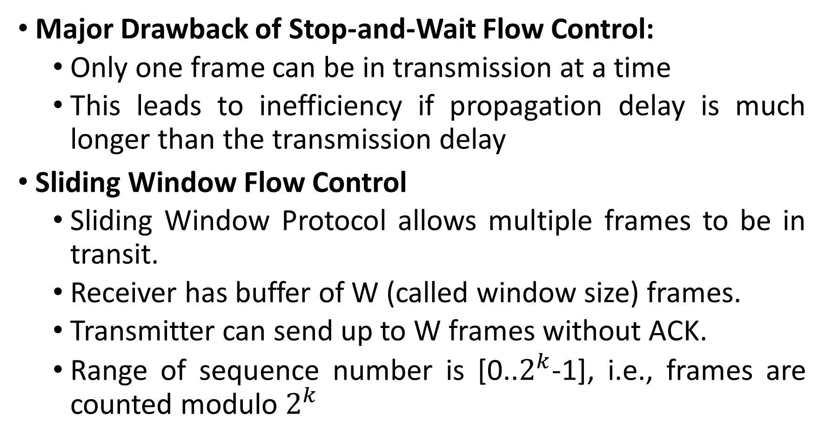
Sliding Window Flow Control
Major Drawback of Stop-and-Wait Flow Control:
  Only one frame can be in transmission at a time
  This leads to inefficiency if propagation delay is much longer than the transmission delay
Sliding Window Flow Control
  Sliding Window Protocol allows multiple frames to be in transit.
  Receiver has buffer of W (called window size) frames.
  Transmitter can send up to W frames without ACK.
  Range of sequence number is [0..$2^{k}$-1], i.e., frames are counted modulo $2^{k}$

Slide 148
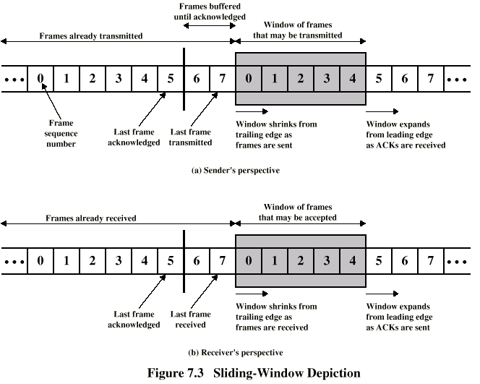

Slide 149
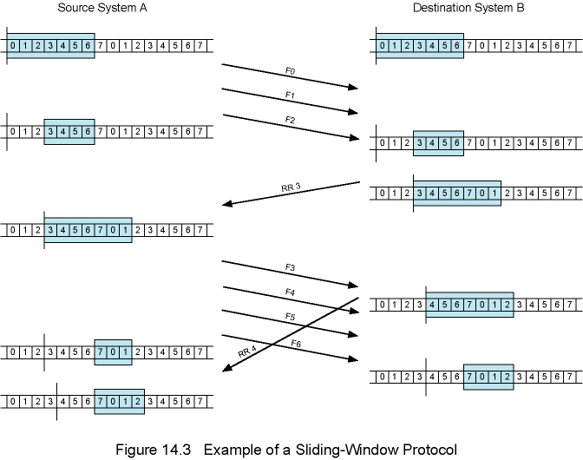

Slide 150
Error Control
Types of errors: Lost frames, damaged frames
Most Error Control techniques are based on
  (1) Error Detection Scheme (e.g., Parity checks, CRC)
  (2) Retransmission Scheme
Error control schemes that involve error detection and retransmission of lost or corrupted frames are referred to as Automatic Repeat Request (ARQ) error control.

Slide 151
Error Control

Slide 152
Stop-and-Wait ARQ
In Stop-and-Wait ARQ, the sender (say station A) transmits a frame and then waits till it receives positive acknowledgement (ACK) or negative acknowledgement (NACK) from the receiver (say station B).
Station B sends an ACK if the frame is received correctly, otherwise it sends NACK.
Station A sends a new frame after receiving ACK; otherwise it retransmits the old frame, if it receives a NACK.
To tackle the problem of a lost or damaged frame, the sender is equipped with a timer.
In case of a lost ACK, the sender transmits the old frame.

Slide 153
Stop-and-Wait ARQ

Slide 154
Stop-and-Wait ARQ
The main advantage of stop-and-wait ARQ is its simplicity.
It also requires minimum buffer size.
However, it makes highly inefficient use of communication links.

Slide 155
Go-Back-N ARQ
In Go-Back-N ARQ, the sender sends the frames continuously without waiting for acknowledgement. That is why it is also called as continuous ARQ.
As the receiver receives the frames, it keeps on sending ACKs or a NACK, in case a frame is incorrectly received.
When the sender receives a NACK, it retransmits the frame in error plus all the succeeding frames.

Slide 157
If a frame is lost, the receiver sends NAK after receiving the next frame.

Slide 158
In case there is long delay before sending the NAK, the sender will resend the lost frame after its timer times out.
If the ACK frame sent by the receiver is lost, the sender resends the frames after its timer times out.

Slide 159
Selective Repeat ARQ
Also called selective retransmission
Only rejected frames are retransmitted
Subsequent frames are accepted by the receiver and buffered
Minimizes retransmissions
Receiver must maintain large enough buffer
Complex system

Slide 160
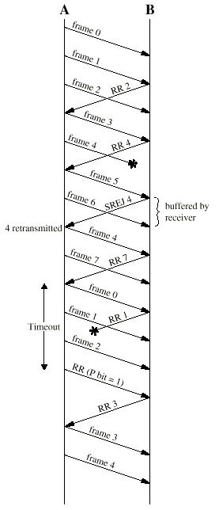
Selective Repeat ARQ

Slide 161
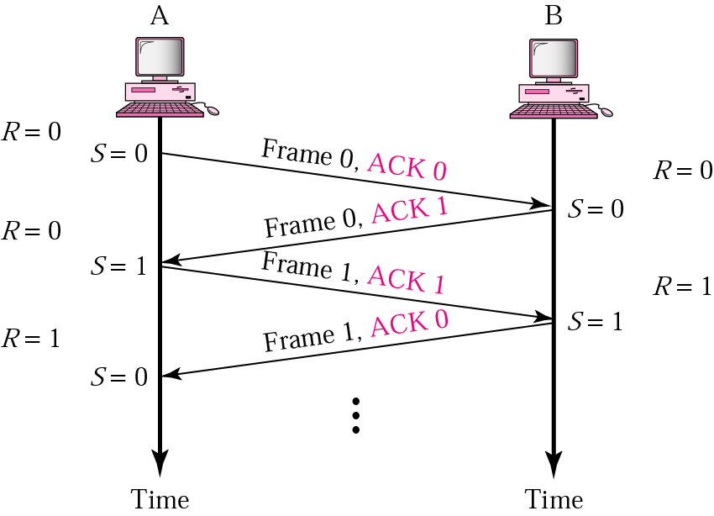
Piggybacking
A method to combine a data frame with ACK.
Station A and B both have data to send.
Instead of sending separately, station A sends a data frame that includes an ACK.
Station B does the same thing.
Piggybacking saves bandwidth.

Slide 162
High-Level Data Link Control (HDLC)
HDLC was defined by ISO for use on both point-to-point and multipoint data links. It supports full-duplex communication
Broadly HDLC features are as follows:
Reliable protocol: selective repeat or go-back-N
Full-duplex communication: receive and transmit at the same time
Bit-oriented protocol: use bits to stuff flags occurring in data i.e, it does NOT recognize or interpret byte value
Flow control: adjust window size based on receiver capability
Uses physical layer clocking and synchronization to send and receive frames

Slide 163
HDLC
Defines three types of stations
  Primary
  Secondary
  Combined
Defines three types of data transfer mode
  Normal Response mode
  Asynchronous Response mode
  Asynchronous Balanced mode
Three types of frames
  Unnumbered
  information
  Supervisory

Slide 164
HDLC
The three stations are :
  Primary station:
    Has the responsibility of controlling the operation of data flow
    Handles error recovery
    Frames issued by the primary station are called commands.
  Secondary station:
    Operates under the control of the primary station.
    Frames issued by a secondary station are called responses.
    The primary station maintains a separate logical link with each secondary station.
  Combined station:
    Acts as both as primary and secondary station.

Slide 165
HDLC
Unbalanced Mode
Commands
Primary
Responses
Secondary
Secondary
Balanced mode
Combined
Combined
commands/Responses

Slide 166
HDLC
The three modes of data transfer operations are
Normal Response Mode (NRM)
  Secondary station can send ONLY when the primary station instruct it to do so
  Two common configurations
  - Point-to-Point link (one primary station and one secondary station)
  - Multipoint link (the primary station maintain different sessions with different secondary stations)
Asynchronous Response Mode (ARM)
  More independent secondary station
  Can send data or control information without explicit permission to do so (note that it is still can not send commands)
Asynchronous Balanced Mode (ABM)
  Mainly used in point-to-point links, for communication between combined stations
  Either stations can send data, control information and commands

Slide 167
HDLC
There are three different classes of frames used in HDLC
  Unnumbered frames, used in link setup and disconnection, and hence do not contain ACK.
  Information frames, which carry actual information. Such frames can piggyback ACK in case of ABM
  Supervisory frames, which are used for error and flow control purposes and hence contain send and receive sequence numbers

Slide 168
Point-to-Point Protocol (PPP)
PPP (Point to Point Protocol) is very popular: used in dial up connection between residential Host and ISP; on SONET/SDH connections, etc
PPP is extremely simple (the simplest in the Data Link protocol family) and very streamlined.
It is a byte oriented protocol.

Slide 169
PPP

Slide 170
PPP Requirements
Pkt framing: encapsulation of packets
bit transparency: must carry any bit pattern in the data field
error detection (no correction)
multiple network layer protocols
connection liveness
Network Layer Address negotiation: Hosts/nodes across the link must learn/configure each other’s network address
PPP non-requirements
error correction/recovery
flow control
sequencing
multipoint links

Slide 171
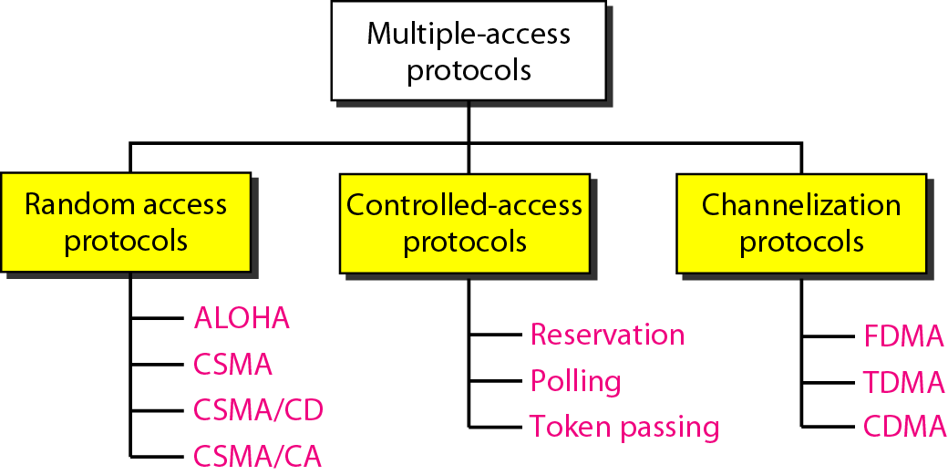
Multiple Access Techniques

Slide 172
Random Access Protocol
No station is superior to another station and none is assigned the control over another.
No station permits, or does not permit, another station to send.
There is no scheduled time for a station to transmit.
No rules specify which station should send next.
Three types of random accesses:
  ALOHA
  Carrier Sense Multiple Access
  Carrier Sense Multiple Access with Collision Detection
  Carrier Sense Multiple Access with Collision Avoidance

Slide 173
ALOHA
Basic idea:
  Let users transmit whenever they have data to be sent.
  When collision occurs, wait a random time ( why? ) and retransmit again.
Differences between regular errors & collision
  Regular errors only affect a single station
  Collision affects more than one
  The retransmission may collide again
  Even the first bit of a frame overlaps with the last bit of a frame almost finished, then two frames are totally destroyed.

Slide 174
Pure ALOHA

Slide 175
Slotted ALOHA
Slotted ALOHA was invented to improve the efficiency of pure ALOHA.
In slotted ALOHA we divide the total time into slots and force the station to send only at the beginning of the time slot.
Because a station is allowed to send only at the beginning of the synchronized time slot, if a station misses this moment, it must wait until the beginning of the next time slot.

Slide 176
Carrier Sense Multiple Access (CSMA)
CSMA method minimize the chance of collision and, therefore, increase the performance.
In CSMA each station first listen to the medium (or check the state of the medium) before sending.
CSMA is based on the principle "sense before transmit" or "listen before talk.“
CSMA can reduce the possibility of collision, but it cannot eliminate it.

Slide 177
Carrier Sense Multiple Access (CSMA)
1-persistent: the station listens before sending. If the channel is busy, it waits until it idle. Transmit when the channel is idle. if collision, the station waits a random amount of time and start all over again.
non-persistent: If busy, the station does not continually sense. Instead, waiting for a random period, then repeating the algorithm.
p-persistent: It applies to slotted channel. If it is idle, it transmits with probability of p.

Slide 178
CSMA-Collision Detection (CD)
Procedure
  Listen to medium and wait until it is free
  Then start talking, but listen to see if someone else starts talking too
  If a collision occurs, stop and then start talking after a random back off time
This scheme is used for hub based Ethernet
Advantages
  More efficient than basic CSMA
Disadvantages
  Requires ability to detect collisions

Slide 179
CSMA-Collision Avoidance (CA)
Procedure
  Similar to CSMA but instead of sending packets control frames are exchanged
  RTS = request to send
  CTS = clear to send
  DATA = actual packet
  ACK = acknowledgement
Advantages
  Small control frames lessen the cost of collisions (when data is large)
  RTS + CTS provide “virtual” carrier sense which protects against hidden terminal collisions (where A can’t hear B)
Disadvantages
  Not as efficient as CSMA-CD
  Doesn’t solve all the problems of MAC in wireless networks (more to come)

Slide 180
Controlled Access Protocols
In controlled access, the stations consult one another to find which station has the right to send.
A station cannot send unless it has been authorized by other stations.
Popular methods of controlled-access:
  Polling
  Reservation
  Token Passing

Slide 181
Controlled Access Protocols – Polling
Polling uses a centralized controller
  which cycles through stations on the network and gives each an opportunity to transmit a packet
The selection step is significant because it means a controller can choose which station to poll at a given time
There are two general polling policies:
  Round robin order
    Round-robin means each station has an equal opportunity to transmit packets
  Priority order
    Priority order means some stations will have more opportunity to send
    For example, priority order might be used to assign an IP telephone higher priority than a personal computer

Slide 182
Controlled Access Protocols – Reservation
It is often used with satellite transmission.
It employs a two-step process in which each round of packet transmissions is planned in advance.
In the first step: Each potential sender specifies whether they have a packet to send during the next round, and the controller transmits a list of the stations that will be transmitting
In the second step: Stations use the list to know when they should transmit
Variations exist: Where a controller uses an alternate channel to gather reservations for the next round. While the current round of transmissions proceeds over the main channel.

Slide 183
Controlled Access Protocols – Token Passing
It is most often associated with ring topologies
Imagine a set of computers connected in a ring
  and imagine that at any instant, exactly one of the computers has received a special control message called a token
When no station has any packets to send
  the token circulates among all stations continuously
For a ring topology, the order of circulation is defined
  if messages are sent clockwise, the next station mentioned in the algorithm refers to the next physical station in a clockwise order
When token passing is applied to other topologies (bus)
  each station is assigned a position in a logical sequence
  and the token is passed according to the assigned sequence

Slide 184
Channelization Protocols
Channelization is a multiple-access method in which the available bandwidth of a link is shared in time, frequency, or through code, between different stations.
Types are:
  Frequency-Division Multiple Access (FDMA)
  Time-Division Multiple Access (TDMA)
  Code-Division Multiple Access (CDMA)

Slide 185
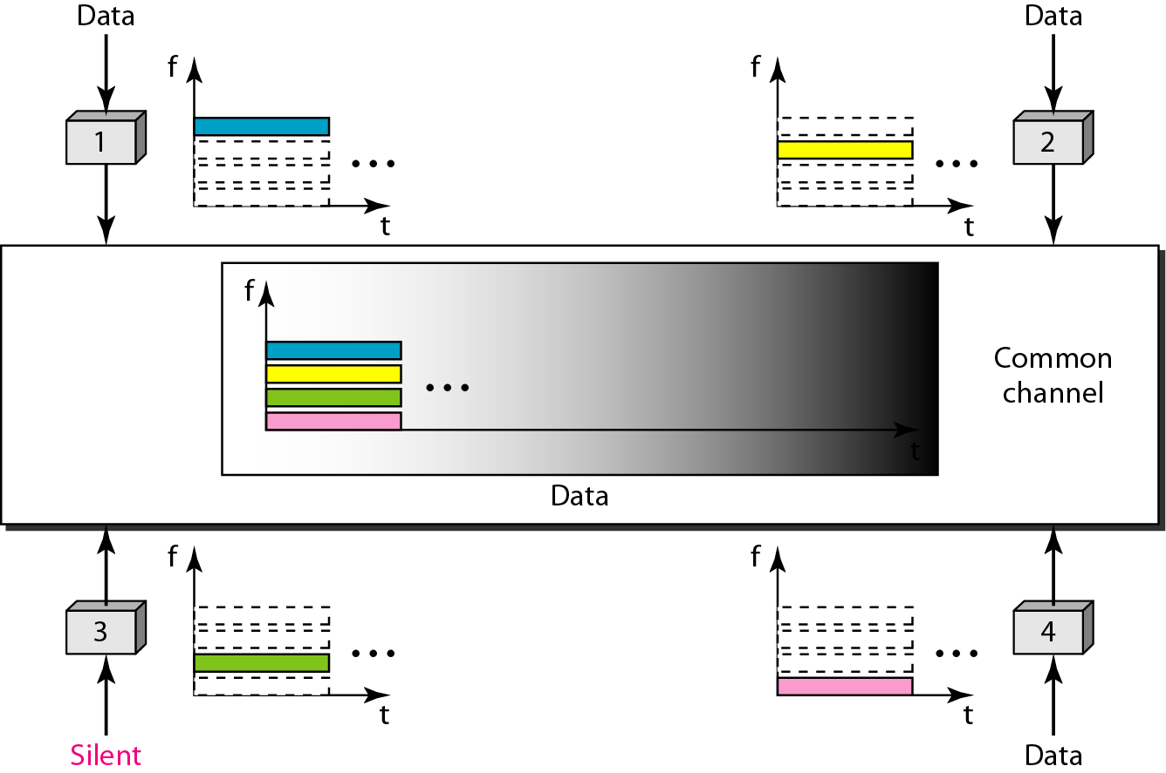
FDMA
In FDMA, the available bandwidth
of the common channel is divided into bands that are separated by guard bands.

Slide 186
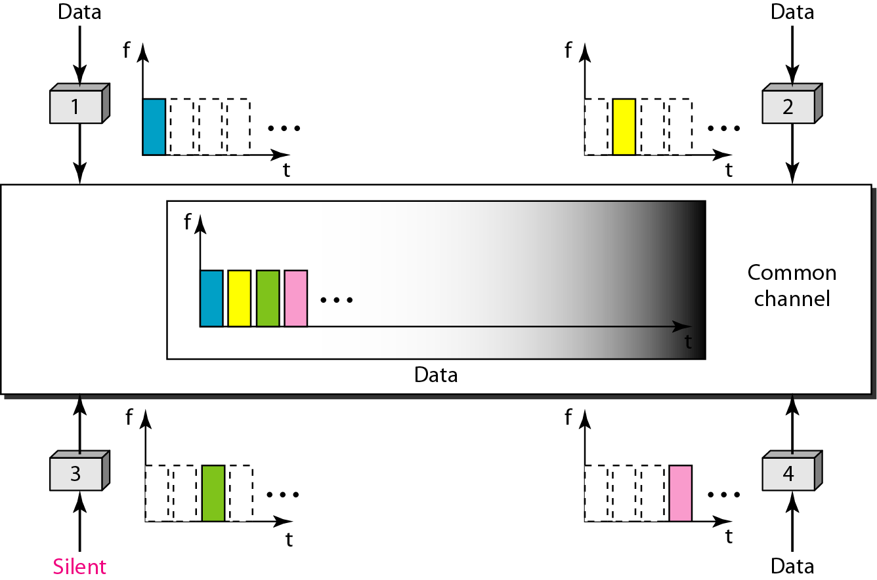
TDMA
In TDMA, the bandwidth is just one channel that is timeshared between different stations.

Slide 187
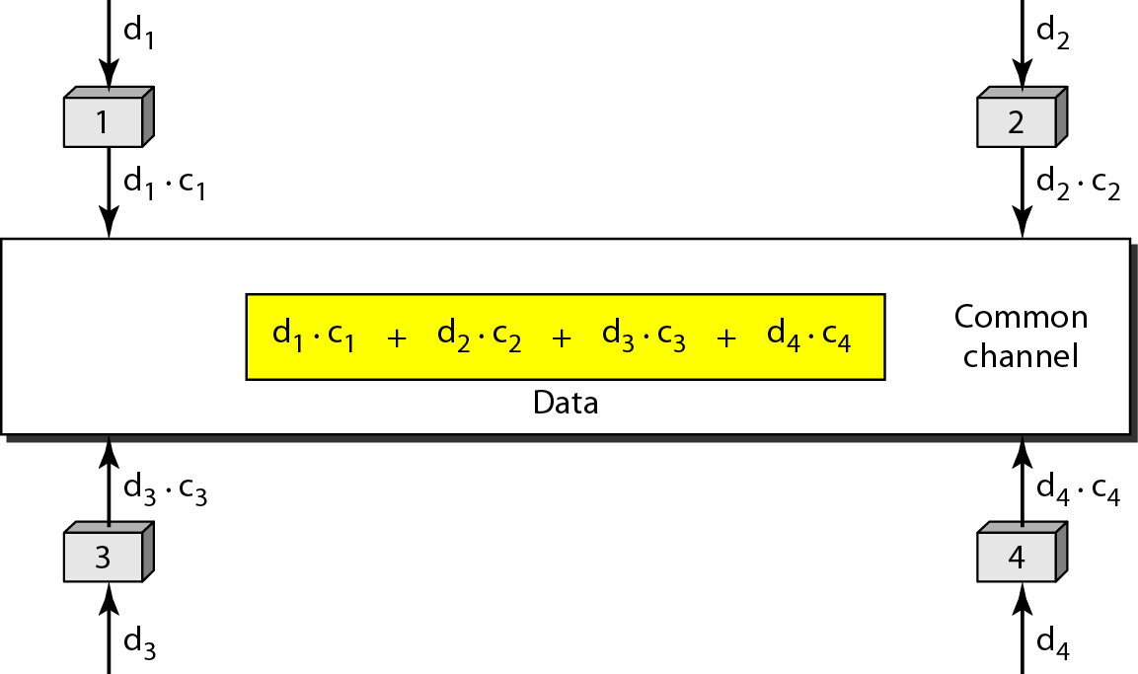
CDMA
In CDMA, one channel carries all transmissions simultaneously.

Slide 188
Networking Devices
Connecting devices fall into five different categories based on the layer in which they operate in a network.

Slide 189
Hubs
Physical Layer devices: essentially hubs
operating at bit levels.
Cables from network devices plug in to the ports on the hub.
Types of HUBS :
  A passive hub is just a connector. It connects the wires coming from different branches.
  The signal pass through a passive hub without regeneration or amplification.
  Connect several networking cables together
  Active hubs or Multiport repeaters-They regenerate or amplify the signal before they are retransmitted.

Slide 190
Repeaters
A repeater is a device that operates only at the PHYSICAL layer.
A repeater can be used to increase the length of the network by eliminating the effect of attenuation on the signal.
It connects two segments of the same network, over coming the distance limitations of the transmission media.
A repeater forwards every frame; it has no filtering capability.
A repeater is a regenerator, not an amplifier.
Repeaters can connect segments that have the same access method. (CSMA/CD, Token Passing, Polling, etc.)

Slide 191
Bridges
Operates in both the PHYSICAL and the data link layer.
As a PHYSICAL layer device, it regenerates the signal it receives.
As a data link layer device, the bridge can check the PHYSICAL/MAC addresses (source and destination) contained in the frame.
A bridge has a table used in filtering decisions.
It can check the destination address of a frame and decide if the frame should be forwarded or dropped.
If the frame is to be forwarded, the decision must specify the port.
A bridge has a table that maps address to ports.
Limit or filter traffic keeping local traffic local yet allow connectivity to other parts (segments).

Slide 192
Two and Three layer switches
Two layer switch operate at Physical and Data link layer
Three layer switch operates at network layer
Bridge is an example of two-layer switch.
Bridge with few port can connect a few LANs
Bridge with many port may be able to allocate a unique port to each station, with each station on its own independent entity. This means no competing traffic (no collision as we saw in Ethernet)

Slide 193
Three layer Switch
E.g. router.
Routes packets based on their logical addresses (host-to-host addressing)
A router normally connects LANs and WANs in the Internet and has a routing table that is used for making decision about the route.
The routing tables are normally dynamic and are updated using routing protocols.

Slide 194
Gateway
Interchangeably used term router and gateway.
Connect two networks above the network layer of OSI model.
Are capable of converting data frames and network protocols into the format needed by another network.
Provide for translation services between different computer protocols.
Transport gateways make a connection between two networks at the transport layer.
Application gateways connect two parts of an application in the application layer, e.g., sending email between two machines using different mail formats.
Broadband-modem-router is one e.g. of gateway.

Slide 195
Backbone Networks
Bus Backbone: In a bus backbone, the topology of the backbone is a bus.
Star Backbone: In a star backbone, the topology of the backbone is a star; the backbone is just one switch.
Connecting Remote LANs: A point-to-point link acts as a LAN in a remote backbone connected by remote bridges.

Slide 196
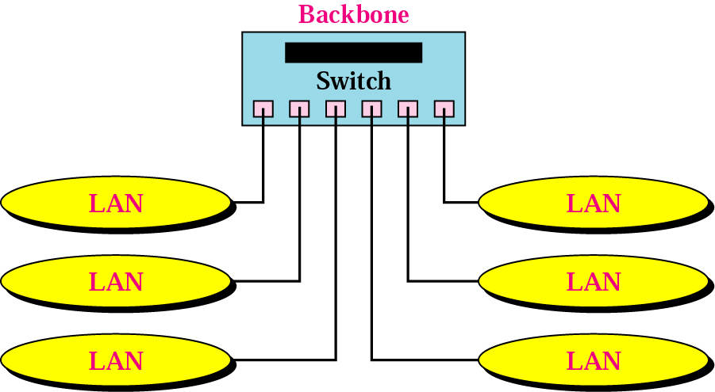
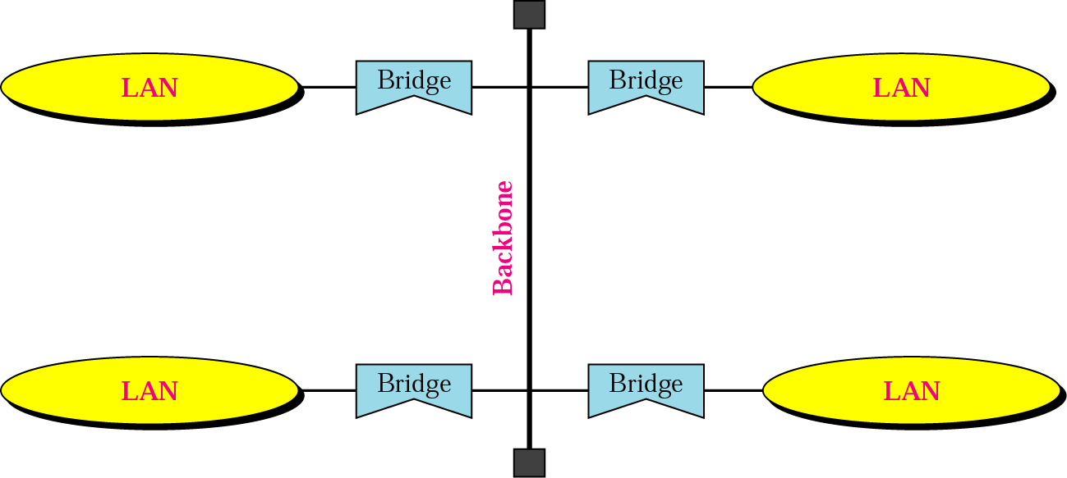
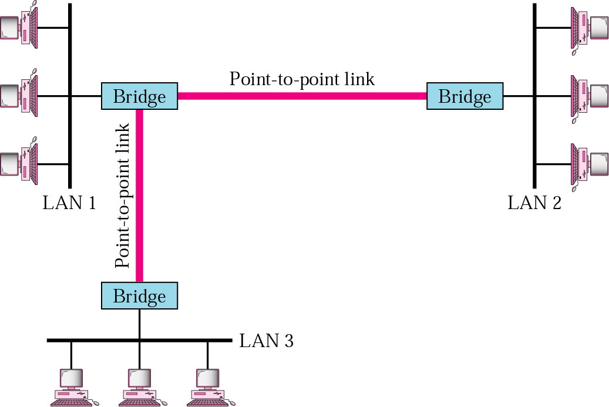

Slide 197
Virtual LAN
A virtual local area network (VLAN) is a group of hosts with a common set of requirements that communicate as if they were attached to the same broadcast domain regardless of their physical location.
A traditional LAN would require all users of the same requirements and same IP subnet (broadcast domain) be connected to the same equipment.
By utilizing VLANs, the same users can be spread out over various geographical locations and still remain in their same IP subnet (broadcast domain).

Slide 198
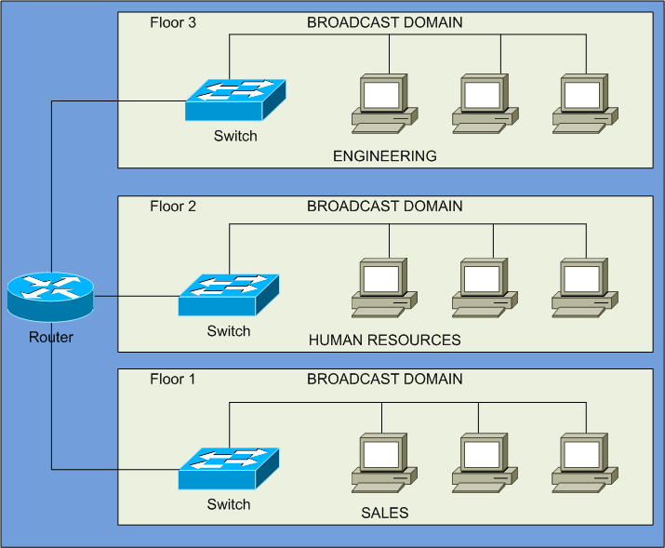
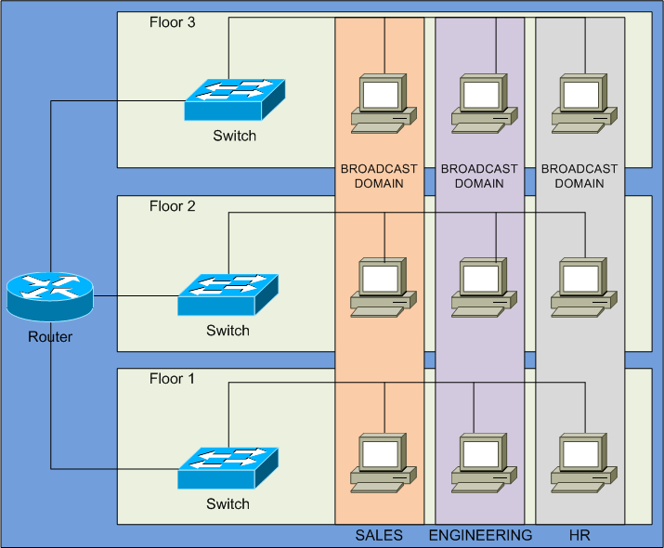
Virtual LAN

Slide 199
Transport Layer and Network Layer
Unit IV
Transport layer-Process to process delivery, Connection oriented & Connectionless Transport, UDP, TCP, congestion control and Quality of Service.
Network Layer: IPv4 address, IPv6 address, Address mapping-ARP, RARP & DHCP, IPv4 datagram detail format, IPv6 datagram detail format, ICMP, IGMP, Network layer issues like Delivery, forwarding, intra-domain and Inter-domain routing, Routing algorithms like Shortest path routing, Flooding, Distance Vector Routing, Link State Routing, Path vector routing etc., Addressing types-Physical, Logical & port address.

Slide 200
Process-to-Process Delivery
The transport layer is responsible for process-to-process delivery—the delivery of a packet, part of a message, from one process to another. Two processes communicate in a client/server relationship,
In Client/Server communication, four entities must be defined:
Sending Node
  Local Host IP
  Local Process Port number
Receiving Node
  Remote host IP
  Remote Process ID Port number

Slide 201
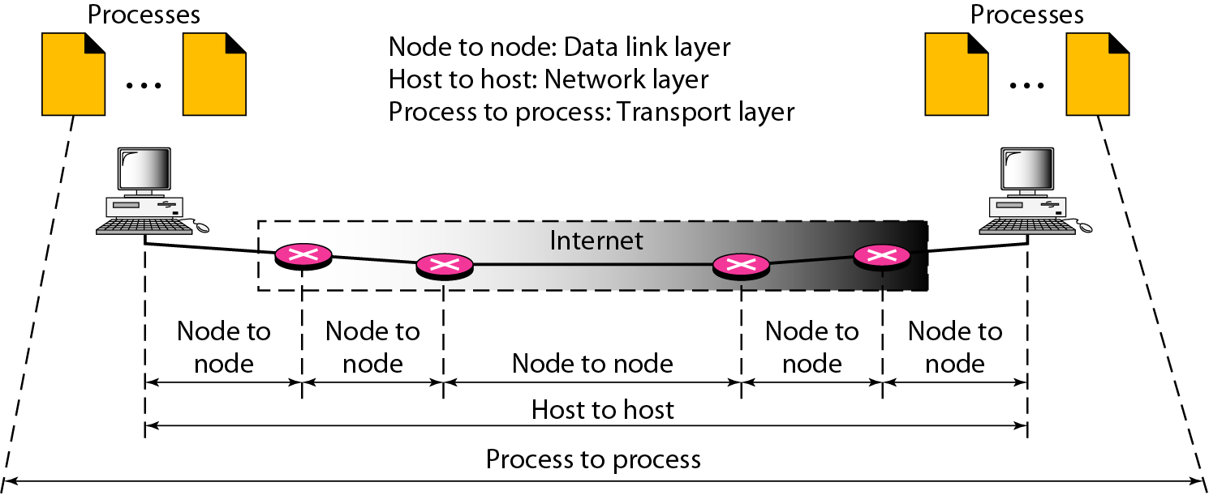
Types of Data Delivery

Slide 202
User Datagram Protocol (UDP)
Connectionless
  No handshaking between UDP sender, receiver
  Each UDP segment handled independently of others
A server application that uses UDP serves only ONE request at a time. All other requests are stored in a queue waiting for service.
Unreliable protocol has no flow and error control
  A UDP segment can be lost, arrive out of order, duplicated, or corrupted
  Checksum field checks error in the entire UDP segment. It is Optional
  UDP doe not do anything to recover from an error it simply discard the segment ➔ Application accepts full responsibility for errors
It uses port numbers to multiplex/demultiplex data from/to the application layer.
Advantages: Simple, minimum overhead, no connection delay
Services provided by UDP:
  Process-to-Process delivery
  Error checking (however, if there is an error UDP does NOT do anything to recover from error. It will just discard the message

Slide 203
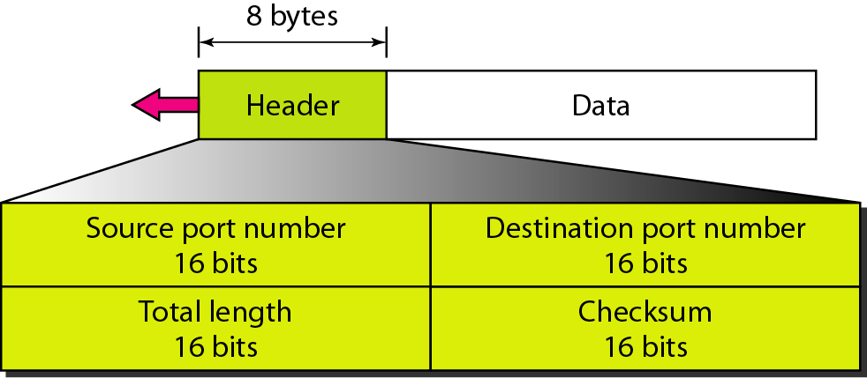
UDP Applications
Used for applications that can tolerate small amount of packet loss:
  Multimedia applications,
  Internet telephony,
  real-time-video conferencing
  Domain Name System messages
  Audio
  Routing Protocols
User datagram format

Slide 204
Transmission Control Protocol (TCP)
Connection-oriented
Connection oriented means that a virtual connection is established before any data is transferred.
Connection ensures that the receiving process is available and ready before the data is sent
Three-way handshaking connection establishment procedure because TCP is full-duplex both side must initialize communication and get approval from the other side before any data transfer,
Virtual connection since TCP protocol will make sure that segments are given to the receiver application in the same order as they were sent by the sender even if they travel through different physical paths
A server application that uses TCP can handle many client requests at the same time each has its own connection.

Slide 205
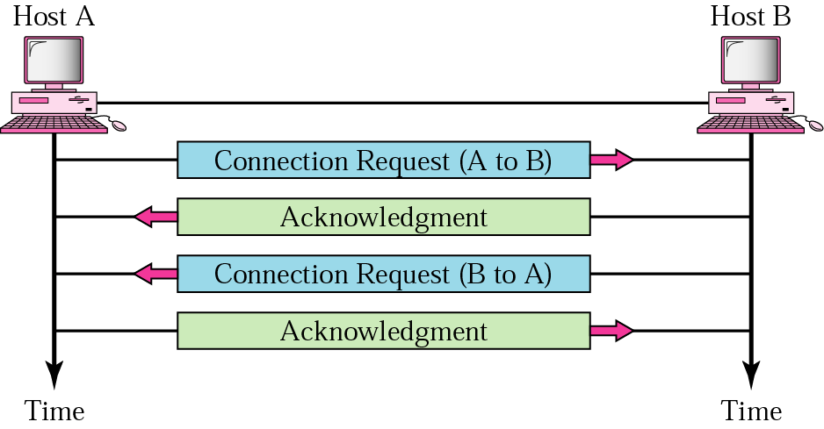
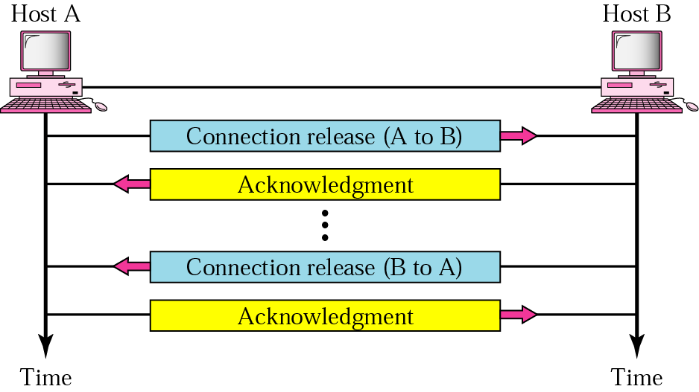
Transmission Control Protocol (TCP)

Slide 206
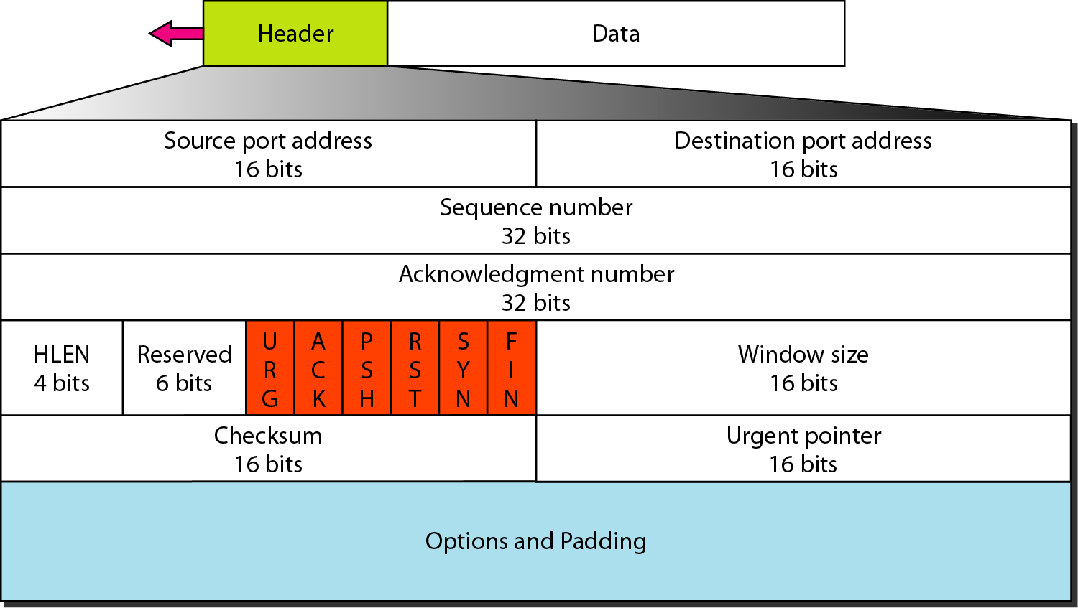
TCP Applications
Following applications require reliable data transfer through TCP:
  WWW using HTTP, Electronic mail using SMTP, Telnet, File transfer using FTP
TCP segment format

Slide 207
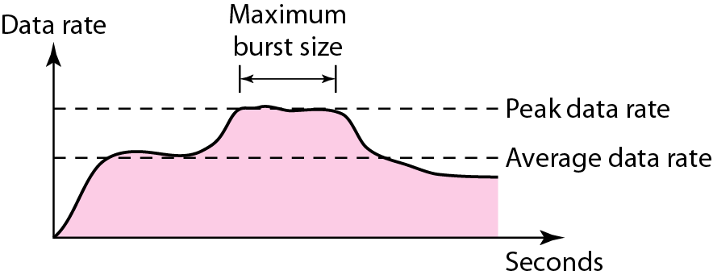
Congestion Control & Quality of Services (QoS)
The main focus of congestion control and quality of service is data traffic.
In congestion control we try to avoid traffic congestion.
In quality of service, we try to create an appropriate environment for the traffic.

Slide 208
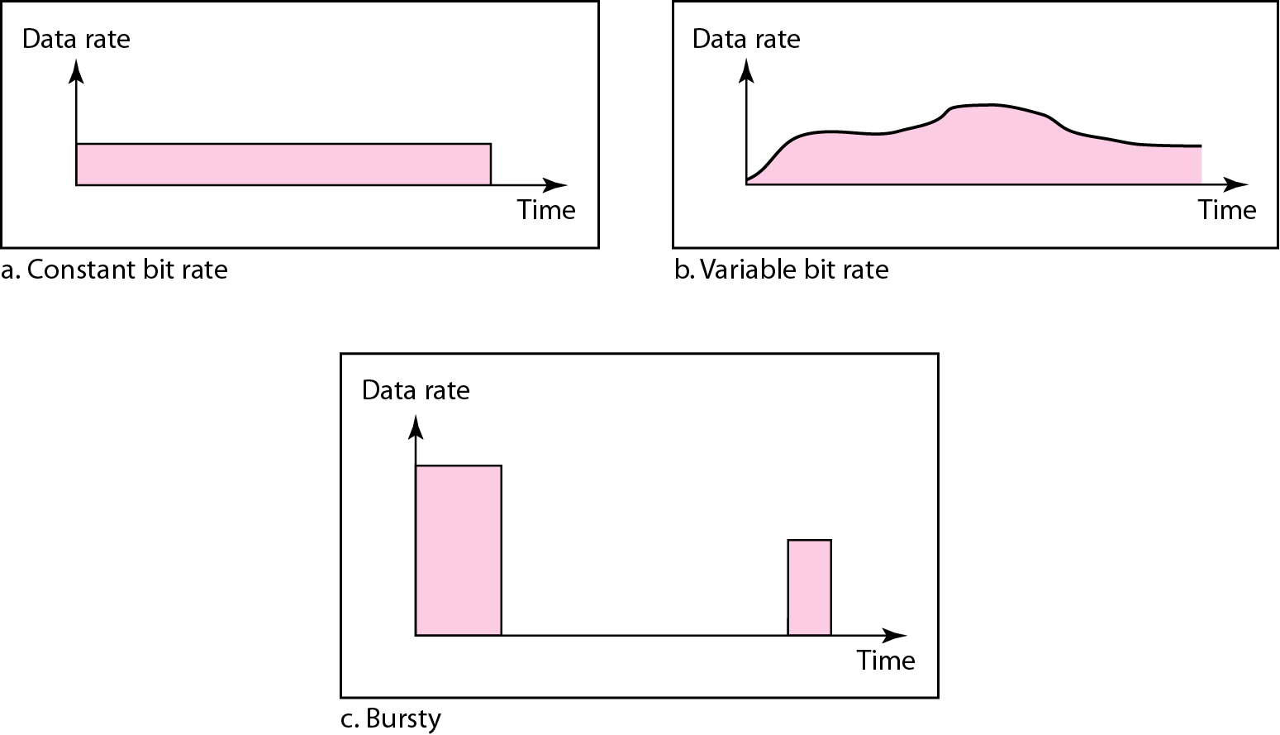
Data Traffic

Slide 209
Congestion Control
Congestion in a network may occur if the number of packets sent to the network is greater than the capacity of the network the number of packets a network can handle.
Congestion control refers to the mechanisms and techniques to control the congestion and keep the load below the capacity.

Slide 210
Congestion Control
Factors that Cause Congestion
Packet arrival rate exceeds the outgoing link capacity.
Insufficient memory to store arriving packets
Bursty traffic
Slow processor
Costs of congestion
large queuing delays are experienced as the packet arrival rate nears the link capacity.
unneeded retransmissions by the sender
when a packet is dropped along a path, the transmission capacity of the upstream routers have been wasted.

Slide 211
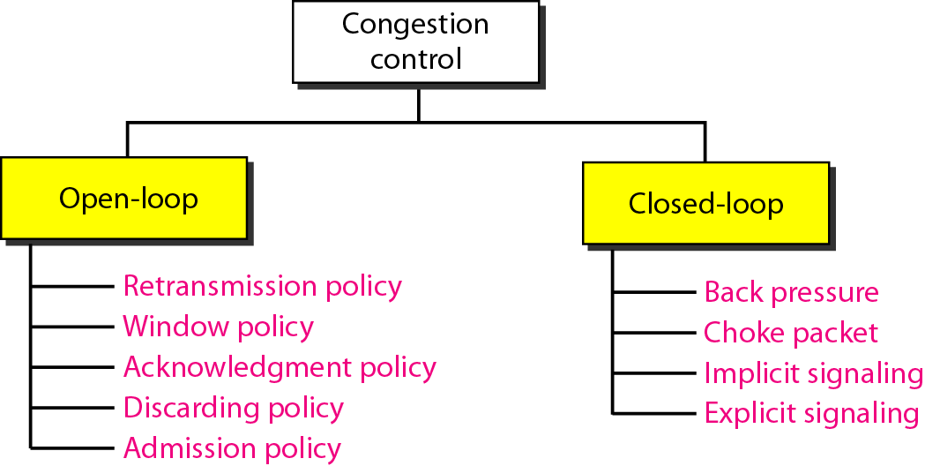
Congestion Control

Slide 212
Open loop congestion control
In this method, policies are used to prevent the congestion before it happens. Congestion control is handled either by the source or by the destination.
1. Retransmission Policy
• The sender retransmits a packet, if it feels that the packet it has sent is lost or corrupted.
• The retransmission policy and the retransmission timers need to be designed to optimize efficiency and at the same time prevent the congestion.
2. Window Policy
• To implement window policy, selective reject window method is used for congestion control in which it sends only the specific lost or damaged packets.

Slide 213
Open loop congestion control
3. Acknowledgement Policy
• If the receiver does not acknowledge every packet it receives it may slow down the sender and help prevent congestion.
4. Discarding Policy
• A router may discard less sensitive packets when congestion is likely to happen
5. Admission Policy
• A router can deny establishing a virtual circuit connection if there is congestion in the "network or if there is a possibility of future congestion.

Slide 214
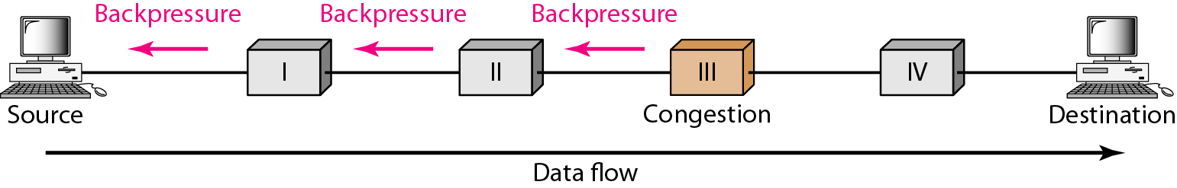
Closed Loop Congestion Control
Closed loop congestion control mechanisms try to remove the congestion after it happens.
1. Backpressure method
• Backpressure is a node-to-node congestion control that starts with a node and propagates, in the opposite direction of data flow in which the congested node stops receiving data from the immediate upstream node(s).

Slide 215
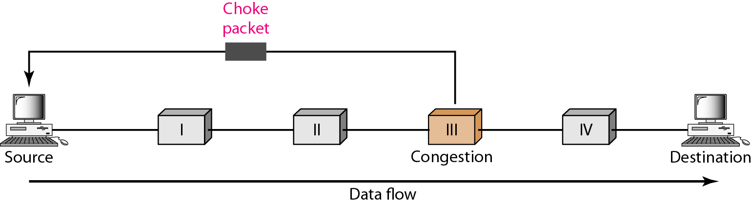
Closed Loop Congestion Control
2. Choke Packet
• In choke packet method, congested node sends a warning directly to the source station i.e. the intermediate nodes through which the packet has traveled are not warned.

Slide 216
Closed Loop Congestion Control
3. Implicit Signaling
• The source guesses that there is congestion somewhere in the network when it does not receive any acknowledgment. Therefore the delay in receiving an acknowledgment is interpreted as congestion in the network and the source slows down.
- this policy is used in TCP(Transmission control protocol).
4. Explicit Signaling
• In this method, the congested nodes explicitly send a signal to the source or destination to inform about the congestion.
• Explicit signaling is different from the choke packet method. In choke packed method, a separate packet is used for this purpose whereas in explicit signaling method, the signal is included in the packets that carry data .

Slide 217
Quality of Services (QoS)
Quality of service is the ability to provide different priority to different applications, users, or data flows, or to guarantee a certain level of performance to a data flow.
Techniques to improve the quality of service:
Scheduling
  Fifo Queuing
  Priority Queuing
  Weighted Fair Queuing
Traffic Shaping
  Leaky Bucket
  Token Bucket
Resource Reservation
Admission Control

Slide 218
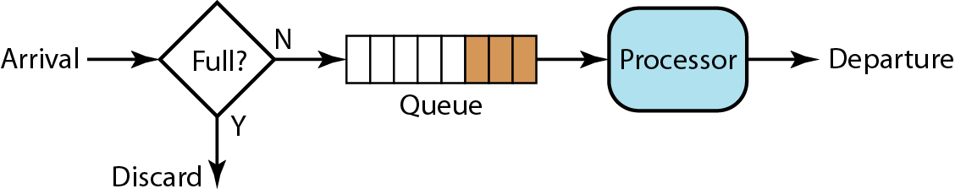
Quality of Services (QoS)
Scheduling:
Packets from different flow arrive at switch or router for processing.
A good scheduling technique treats the different flow in a fair and appropriate manner.
FIFO Queuing:

Slide 219
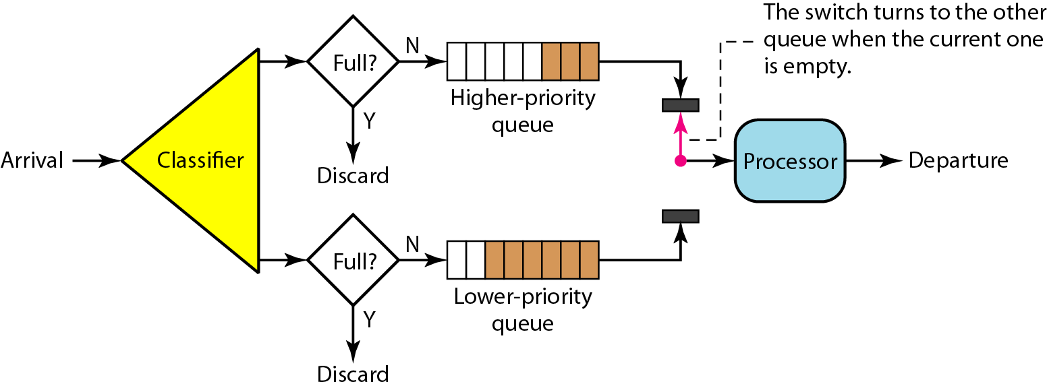
Quality of Services (QoS)
Priority Queuing:

Slide 220
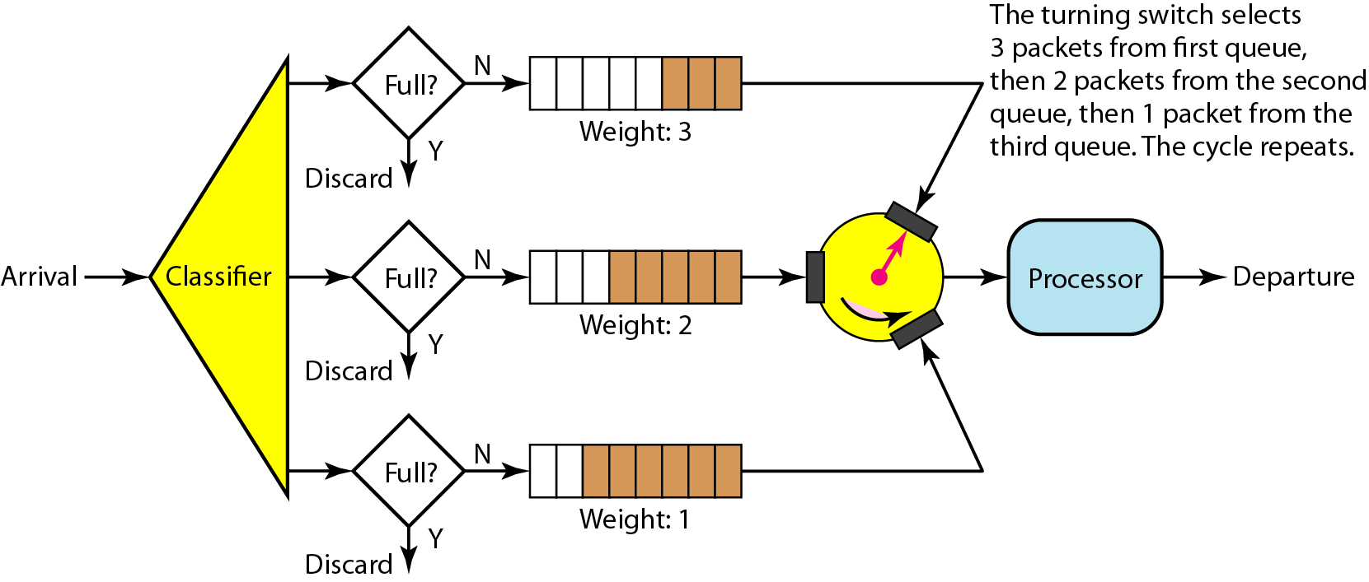
Quality of Services (QoS)
Weighted Fair Queuing:

Slide 221
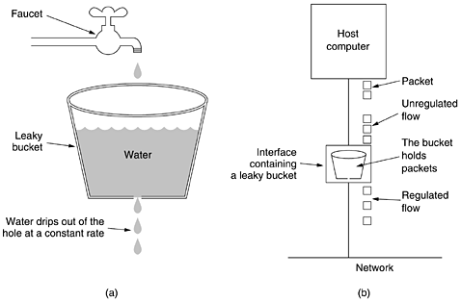
Quality of Services (QoS)
Traffic Shaping: Is the mechanism to control the amount
and the rate of the traffic sent to the network.
Leaky Bucket:

Slide 222
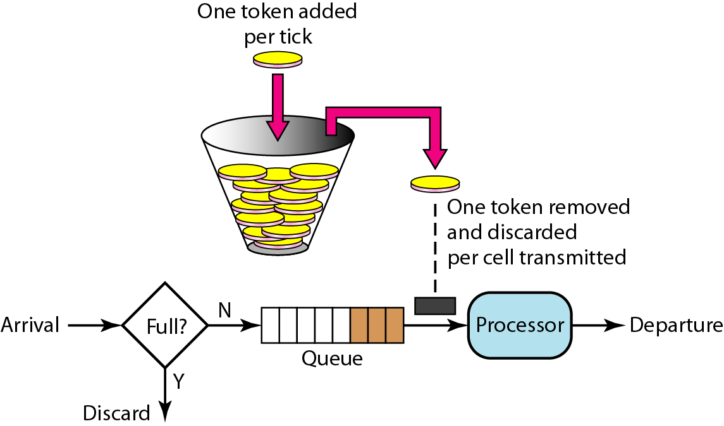
Quality of Services (QoS)
Token Bucket

Slide 223
Quality of Services (QoS)
Resource Reservation:
  A flow of data needs resources such as buffer, bandwidth, CPU time, and so on.
  QoS can be improved if these resources are reserved beforehand.
Admission Control:
  Routers or switches puts restrictions on the admission of packets from host.
  Before a router accepts the flow, it checks the flow for specifications in terms of bandwidth, buffer size ,cpu speed etc.

Slide 224
IP Address and its Format
IP defines an addressing scheme that is independent of the underlying physical address (MAC).
IP specifies a unique 32-bit number for each host on a network.
The 32-bit IP address is grouped eight bits at a time, separated by dots, and represented in decimal format (known as dotted decimal notation).
Each bit in the octet has a binary
weight (128, 64, 32, 16, 8, 4, 2, 1).
The minimum value for an octet is 0,
and the maximum value for an
octet is 255.

Slide 225
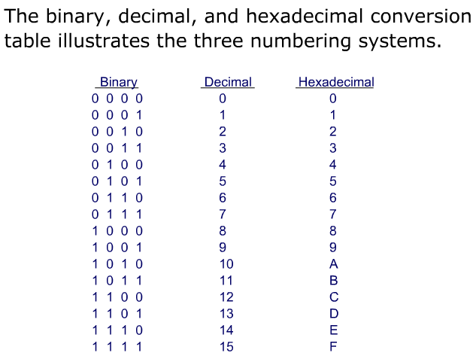
IP Address and its Format

Slide 226
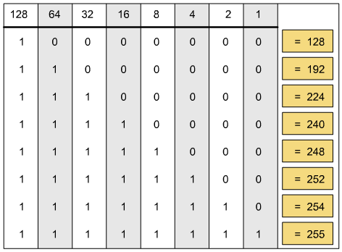
IP Address and its Format
Decimal Equivalents of 8-Bit Patterns

Slide 227
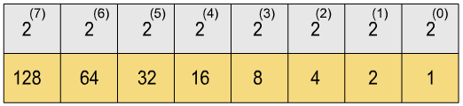
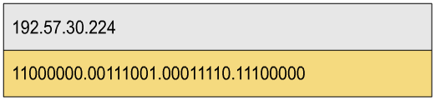
IP Address and its Format
Binary and Decimal Conversion

Slide 228
IP Address and its Format
Change the following IPv4 addresses from binary notation to dotted-decimal notation.
Solution
We replace each group of 8 bits with its equivalent decimal number and add dots for separation.

Slide 229
IP Address and its Format
Change the following IPv4 addresses from dotted-decimal notation to binary notation.
Solution
We replace each decimal number with its binary equivalent (see Appendix B).

Slide 230
IP Address and its Format
Find the error, if any, in the following IPv4 addresses.
Solution
a. There must be no leading zero (045).
b. There can be no more than four numbers.
c. Each number needs to be less than or equal to 255.
d. A mixture of binary notation and dotted-decimal
notation is not allowed.

Slide 231
Classful IP addresses
Class A addresses: These addresses use 7 bits for the <network> and 24 bits for the <host> portion of the IP address. This allows for 2⁷ -2 (126) networks each with 2²⁴ -2 (16777214) hosts—a total of more than 2 billion addresses.
Class B addresses: These addresses use 14 bits for the <network> and 16 bits for the <host> portion of the IP address. This allows for 2¹⁴ -2 (16382) networks each with 2¹⁶ -2 (65534) hosts—a total of more than 1 billion addresses.
Class C addresses: These addresses use 21 bits for the <network> and 8 bits for the <host> portion of the IP address. That allows for 2²¹ -2 (2097150) networks each with 2⁸ -2 (254) hosts—a total of more than half a billion addresses.
Class D addresses: These addresses are reserved for multicasting (a sort of broadcasting, but in a limited area, and only to hosts using the same Class D address).
Class E addresses: These addresses are reserved for future or experimental use.

Slide 232
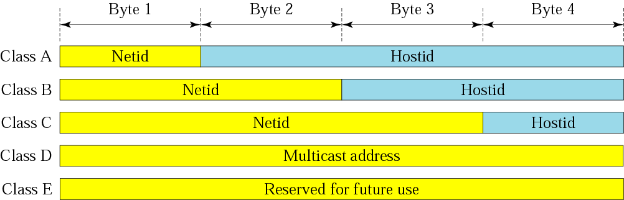
Classful IP addresses

Slide 233
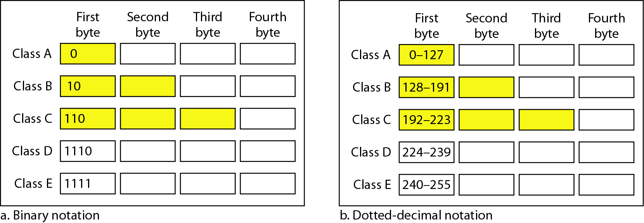
Classful IP addresses

Slide 234
Classful IP addresses
Find the class of each address.
a. 00000001 00001011 00001011 11101111
b. 11000001 10000011 00011011 11111111
c. 14.23.120.8
d. 252.5.15.111
Solution
a. The first bit is 0. This is a class A address.
b. The first 2 bits are 1; the third bit is 0. This is a class C
address.
c. The first byte is 14; the class is A.
d. The first byte is 252; the class is E.

Slide 235
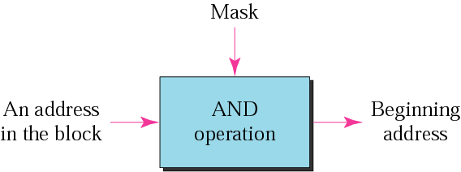
Classful IP addresses
Mask:
A mask is a 32-bit binary number.
The mask is ANDeD with IP address to get
  The bloc address (Network address)
  Mask And IP address = Block Address

Slide 236
IP Address and its Format
Default Mask:
Class A default mask is 255.0.0.0
Class B default mask is 255.255.0.0
Class C Default mask 255.255.255.0
Subnet Mask:

Slide 237
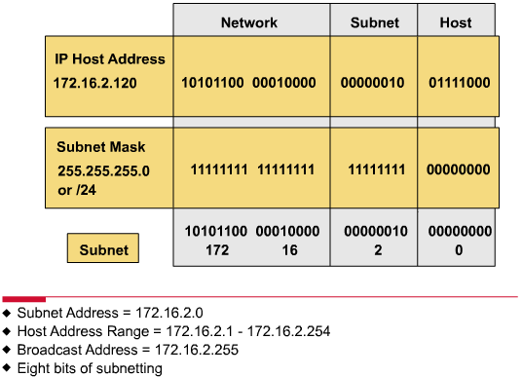

Slide 238
IPv6
IPv6 or IP version 6 is the next generation Internet protocol which will eventually replace the current protocol IPv4.
IPv6 has a number of improvements and simplifications when compared to IPv4.
The primary difference is that IPv6 uses 128 bit addresses as compared to the 32 bit addresses used with IPv4.
In IPv4 there is a total of 4,294,967,296 IP addresses, whereas in IPv6, there is a total of 18,446,744,073,709,551,616 IP addresses.
A significant difference between IPv6 and IPv4 is the address notation. IPv4 uses a period (.) between each octet, compared to IPv6 which uses a colon (:).

Slide 239
IPv6
128-bit Address
3FFE:085B:1F1F:0000:0000:0000:00A9:1234
8 groups of 16-bit hexadecimal numbers separated by “:”
Leading zeros can be removed
3FFE:85B:1F1F::A9:1234
:: = all zeros in one or more group of 16-bit hexadecimal numbers

Slide 240
Network Address Translation (NAT)
With the increasing number of internet users requiring an unique IP address for each host, there is an acute shortage of IP addresses.
The Network Address Translation (NAT) approach is a quick interim solution to this problem.
NAT allows a large set of IP addresses to be used in an internal (private) network and a handful of addresses to be used for the external internet.
The internet authorities has set aside three sets of addresses to be used as private addresses.

Slide 241
NAT
A router is used to perform the operation of address translation between the private network and the internet.

Slide 242
Address Resolution Protocol (ARP)
It may be noted that the knowledge of hosts’ IP address is not sufficient for sending packets, because data link hardware does not understand internet addresses.
In an Ethernet network, the Ethernet controller card can send and receive using 48-bit Ethernet addresses.
The 32-bit IP addresses are unknown to these cards.
This requires a mapping of the IP addresses to the corresponding Ethernet addresses.
This mapping is accomplished by using a technique known as Address Resolution Protocol (ARP).

Slide 243
Address Resolution Protocol (ARP)
An ARP request is broadcast to
all stations in the network
An ARP reply is an unicast to
the host requesting the mapping

Slide 244
Reverse ARP (RARP)
The TCP/IP protocols include another related protocol known as reverse ARP, which can be used by a computer such as a diskless host to find out its own IP address. It involves the following steps:
  Diskless host A broadcasts a RARP request specifying itself as the target.
  RARP server responds with the reply directly to host A.
  Host A preserves the IP address in its main memory for future use until it reboots.

Slide 245
Dynamic Host Configuration Protocol (DHCP)
It is a method for assigning Internet Protocol (IP) addresses permanently or to individual computers in an organization’s network.
DHCP lets a network administrator supervise and distribute IP addresses from a central point and automatically sends a new IP address when a computer is plugged into a different place in the network.
Two types of IP addresses:
  Static
    Is a number that is assigned to a computer by an Internet service provider (ISP) to be its permanent address on the Internet
  Dynamic
    The temporary IP address is called a dynamic IP address

Slide 246
DHCP
Advantages:
  DHCP minimizes the administrative burden
  By using DHCP there is no chance to conflict IP address
  By using DHCP relay agent you provide IP address to another network
Disadvantages:
  When DHCP server is unavailable, client is unable to access enterprises network
  Your machine name does not change when you get a new IP address

Slide 247
Internet Control Message Protocol (ICMP)
IP provides unreliable connectionless datagram service.
IP do not have error control and assistance mechanisms.
The internet control message protocol (ICMP) has been designed to take care of the above deficiencies.
It is a companion to IP.
ICMP in spite of being a network layer protocol does not pass messages directly to the datalink layer.
Instead the messages are first encapsulated inside IP datagrams whose protocol field is set to 1.

Slide 248
Internet Control Message Protocol (ICMP)
Types of messages
ICMP messages are divided into two broad categories:
  Error reporting Messages
  Query Messages
Error Reporting Messages: ICMP does not correct errors, but only reports them. Error reporting messages are always sent to the original source. Five types of errors are handled:
  Destination unreachable—where a router cannot route a datagram or a host
  Source Quench—flow control and congestion control
  Time Exceeded—message do not arrive at the destination host within a certain time limit
  Parameter Problem—destination host discovers an ambiguous or missing value in a any field of the datagram
  Redirection—host may send a datagram to the wrong router

Slide 249
Internet Control Message Protocol (ICMP)
Query Messages: Query messages are used to diagnose some network problems. There are four different pairs of messages.
Echo Request/Reply messages—are designed for diagnostic purposes. Their combination determines whether two systems can communicate with each other.
Time stamp Request/Reply messages—can be used to determine the round trip time for an IP datagram to travel between two machines and also to synchronize the clocks in them.
Address mask Request/Reply message—are used between the host and the router to indicate which part of the address defines the network and the sub-network address and which part corresponds to the host identifier.
Router Solicitation and Advertisement—are useful to inform a host that wants to send data to a host on another network.

Slide 250
Internet Group Management Protocol (IGMP)
One-to-many communication
One of the necessary, but not sufficient, protocols that is involved in multicasting
A protocol that manages group membership
Not a multicasting routing protocol
  For multicasting, we need routing tables in routers to route multicast packets
  This is done by the multicasting routing protocols
  However, IGMP does not address this
IGMP gives the multicast routers information about the membership status of hosts (routers) connected to the network.
Help a multicast router create and update a list of loyal members related to each router interface.

Slide 251
IGMP Message Types

Slide 252
Network Layer Design Issues:
Delivery, Forwarding, and Routing
Delivery refers to the way a packet is handled by the underlying networks under the control of the network layer.
Forwarding refers to the way a packet is delivered to the next station.
Routing refers to the way routing tables are created to help in forwarding.

Slide 253
Network Layer Design Issues: Delivery
DELIVERY
The network layer supervises the handling of the packets by the underlying physical networks. We define this handling as the delivery of a packet.
Direct Delivery:
In a direct delivery, the final destination of the packet is a host connected to the same physical network as the deliverer.
Direct delivery occurs when the source and destination of the packet are located on the same physical network.

Slide 254
Network Layer Design Issues: Delivery
Indirect Delivery:
If the destination host is not on the same network as the deliverer, the packet is delivered indirectly.
In an indirect delivery, the packet goes from router to router until it reaches the one connected to the same physical network as its final destination.

Slide 255
Network Layer Design Issues: Forwarding
Forwarding
Forwarding means to place the packet in its route to its destination.
Forwarding requires a host or a router to have a routing table.
When a host has a packet to send or when a router has received a packet to be forwarded, it looks at this table to find the route to the final destination.
Forwarding Techniques
Next-Hop Method Versus Route Method: The routing table holds only the address of the next hop instead of information about the complete route.
Network-Specific Method Versus Host-Specific Method: Instead of having an entry for every destination host connected to the same physical network, it has only one entry that defines the address of the destination network itself.

Slide 256
Network Layer Design Issues: Routing
A routing table can be either static or dynamic.
A static table is one with manual entries.
A dynamic table, on the other hand, is one that is updated automatically when there is a change somewhere in the internet.
A router receives a packet from a network and passes it to another network.
Intra- and Inter-domain Routing
An autonomous system (AS) is a group of networks and routers under the authority of a single administration.
Routing inside an autonomous system is referred to as intra-domain routing.
Routing between autonomous systems is referred to as inter-domain routing.

Slide 257
Routing Protocols
Routing Information Protocol (RIP) is an implementation of the distance vector protocol.
Open Shortest Path First (OSPF) is an implementation of the link state protocol.
Border Gateway Protocol (BGP) is an implementation of the path vector protocol.

Slide 258
Distance Vector Routing

